Slide 1
Chapter 4 Introduction to Cascading Style Sheets (CSS): Part 1
Internet & World Wide Web How to Program, 5/e

Slide 2
스스로 배우기
w3schools.com
www.w3schools.com/css/

Slide 3
예제
http://www.pixy.cz/blogg/clanky/css-fieldsetandlabels.html
www.csszengarden.com

Slide 4
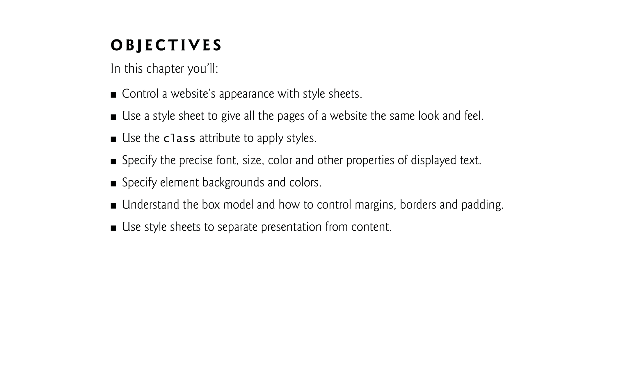

Slide 5
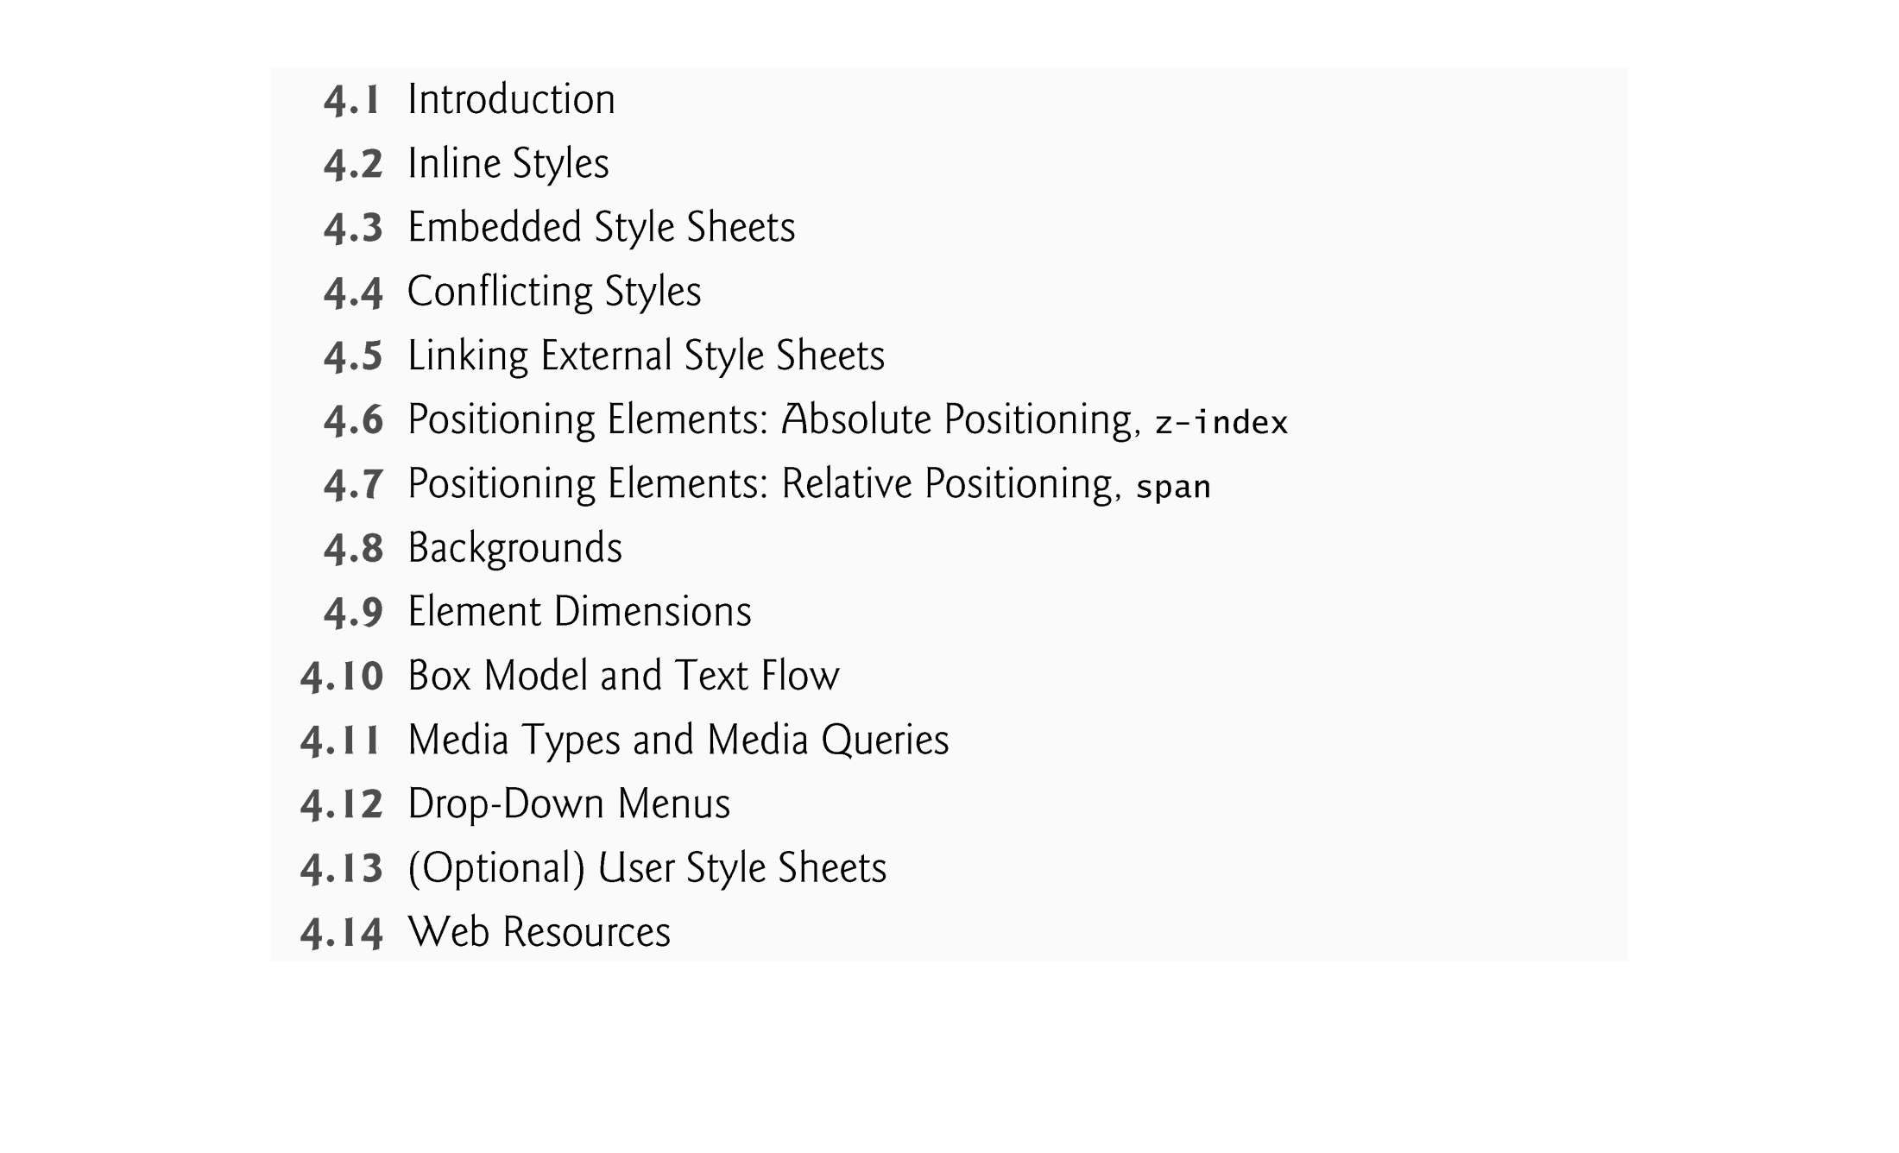

Slide 6
4.1 Introduction
Cascading Style Sheets 3 (CSS3)
Used to specify the presentation of elements separately from the structure of the document.
CSS validator
jigsaw.w3.org/css-validator/
This tool can help you make sure that your code is correct and will work on CSS3-compliant browsers.

Slide 7
4.2 Inline Styles
Inline style
declare an individual element’s format using the HTML5 attribute style.
Figure 4.1 applies inline styles to p elements to alter their font size and color.
Each CSS property is followed by a colon and the value of the attribute
Multiple property declarations are separated by a semicolon

Slide 8
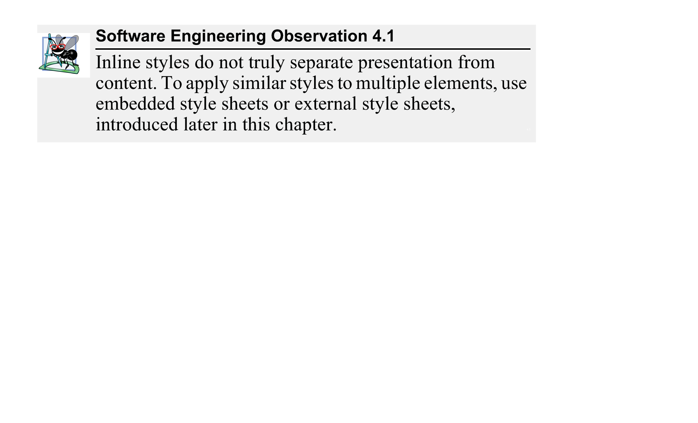

Slide 9
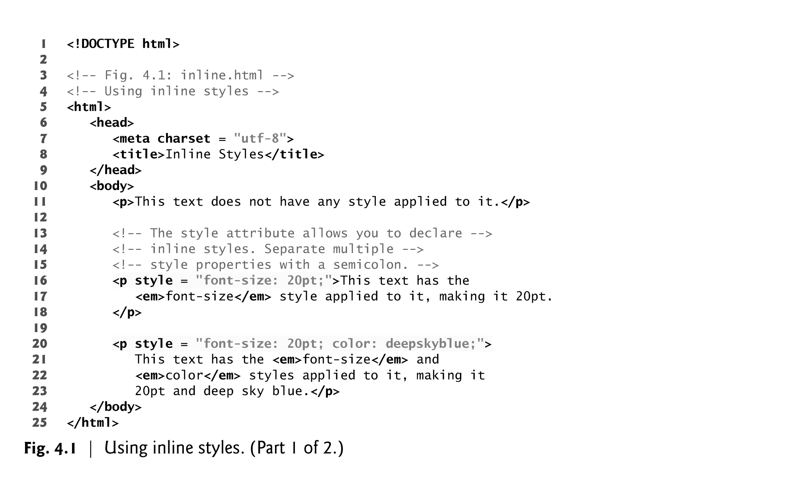

Slide 10
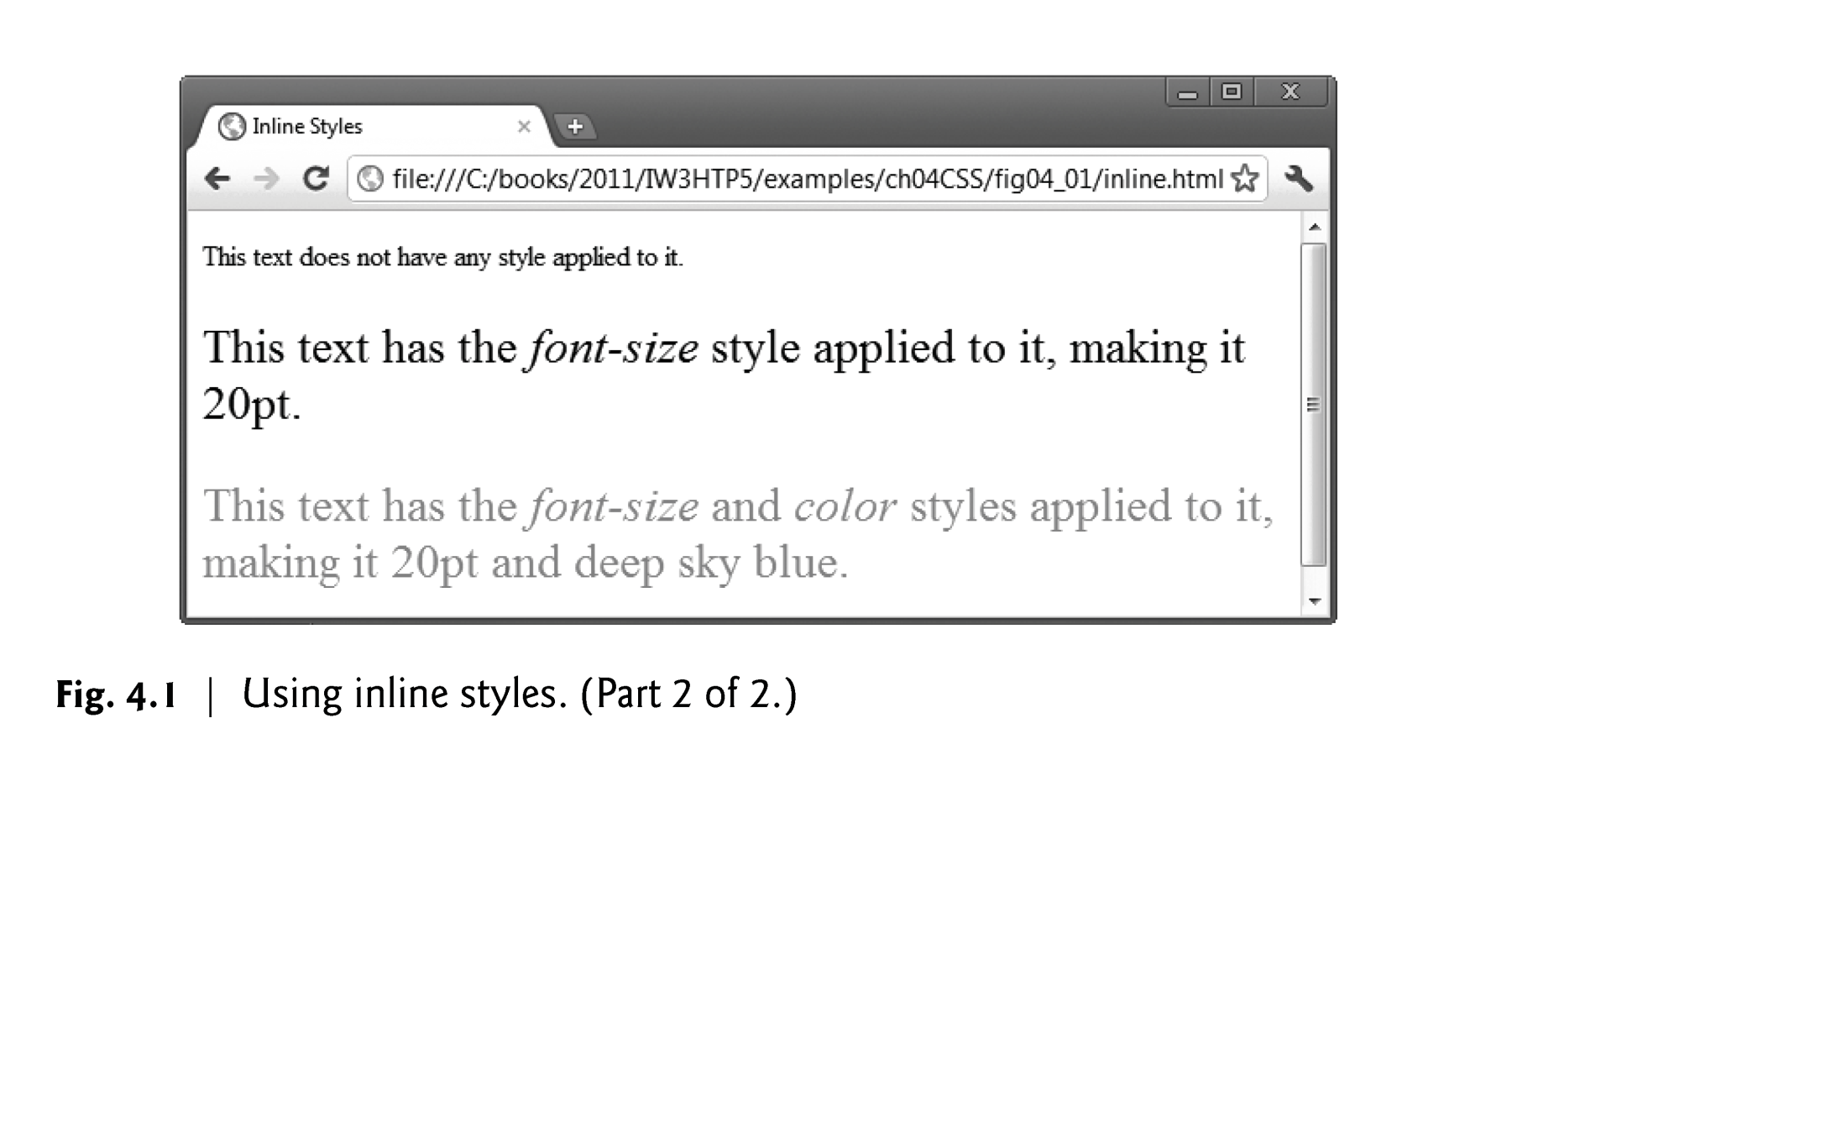

Slide 11
4.2 Inline Styles (Cont.)
color property sets text color
Color names and hexadecimal codes may be used as the color property value.
Figure 4.2 contains the HTML standard color set.
A list of extended hexadecimal color codes and color names is provided in Appendix B.
You can also find a complete list of HTML standard and extended colors at
www.w3.org/TR/css3-color/

Slide 12
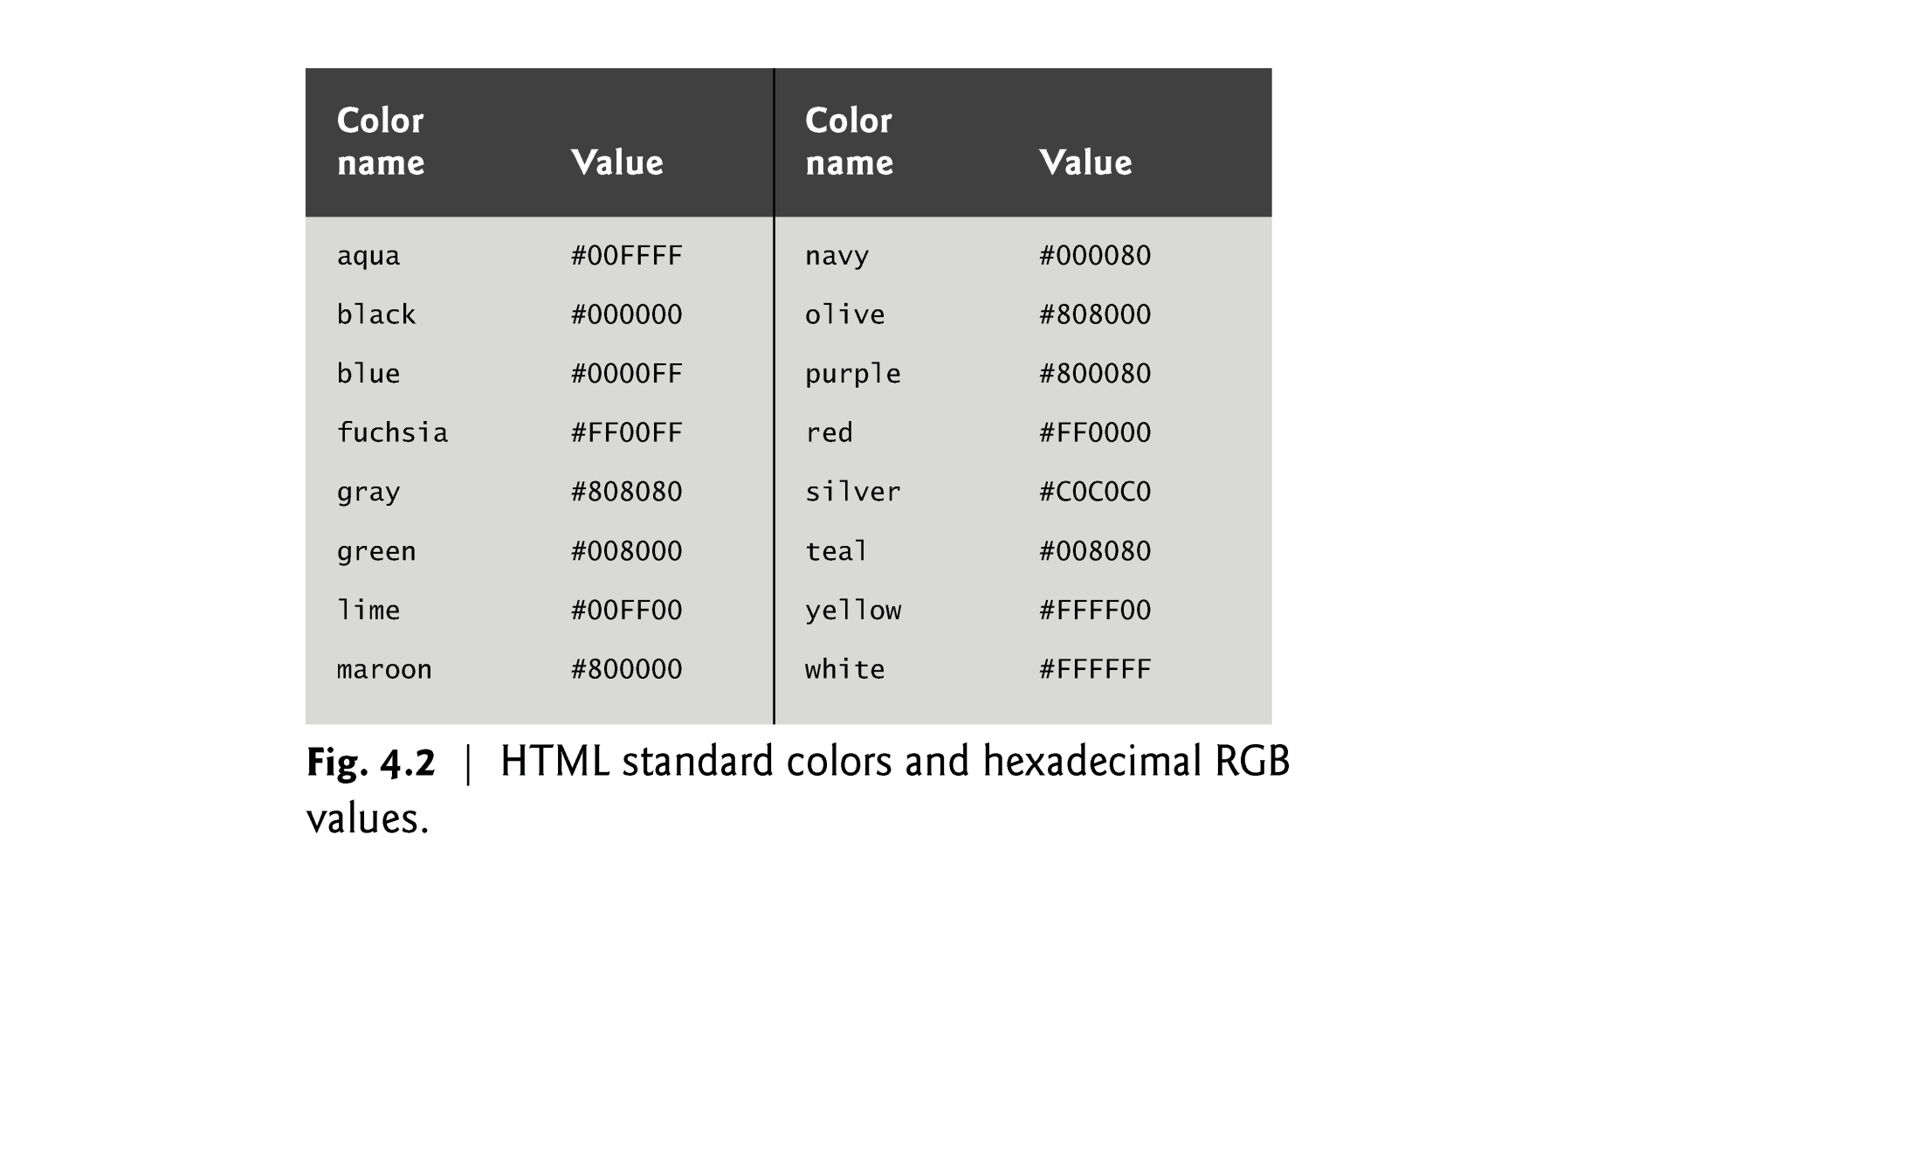

Slide 13
4.3 Embedded Style Sheets
A second technique for using style sheets is embedded style sheets, which enable you to embed a CSS3 document in an HTML5 document’s head section.
Figure 4.3 creates an embedded style sheet containing four styles.

Slide 14
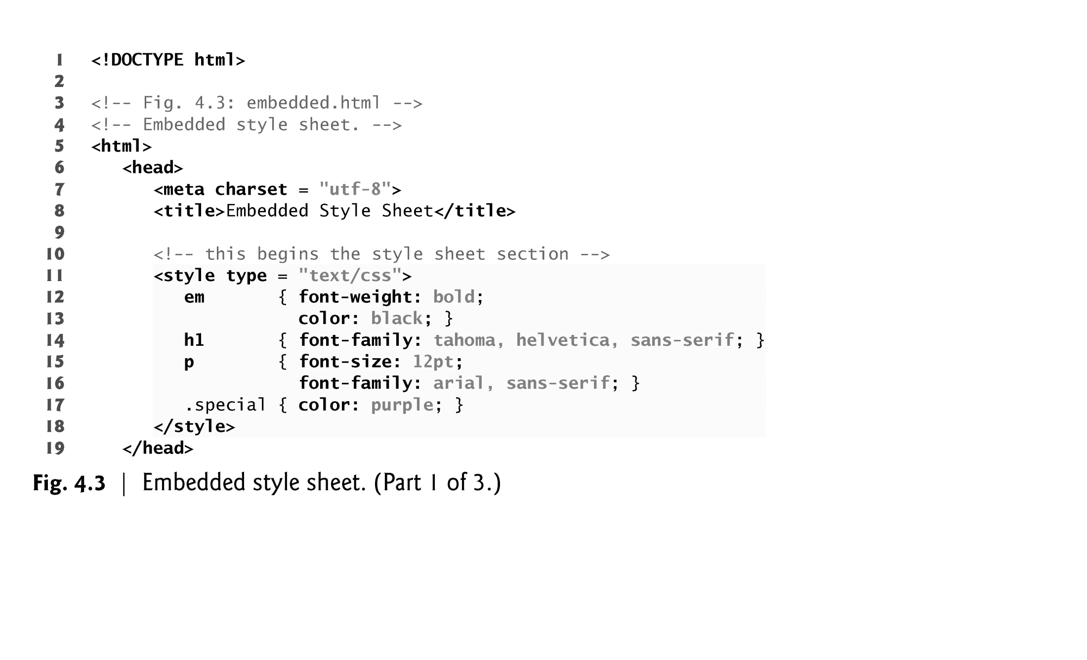

Slide 15
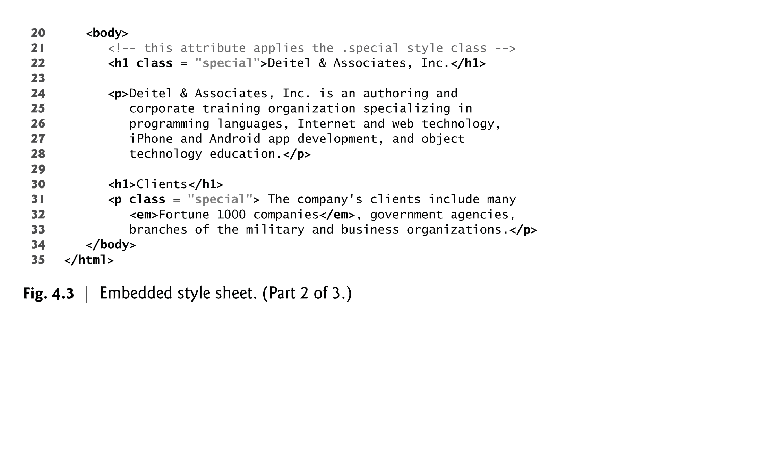

Slide 16
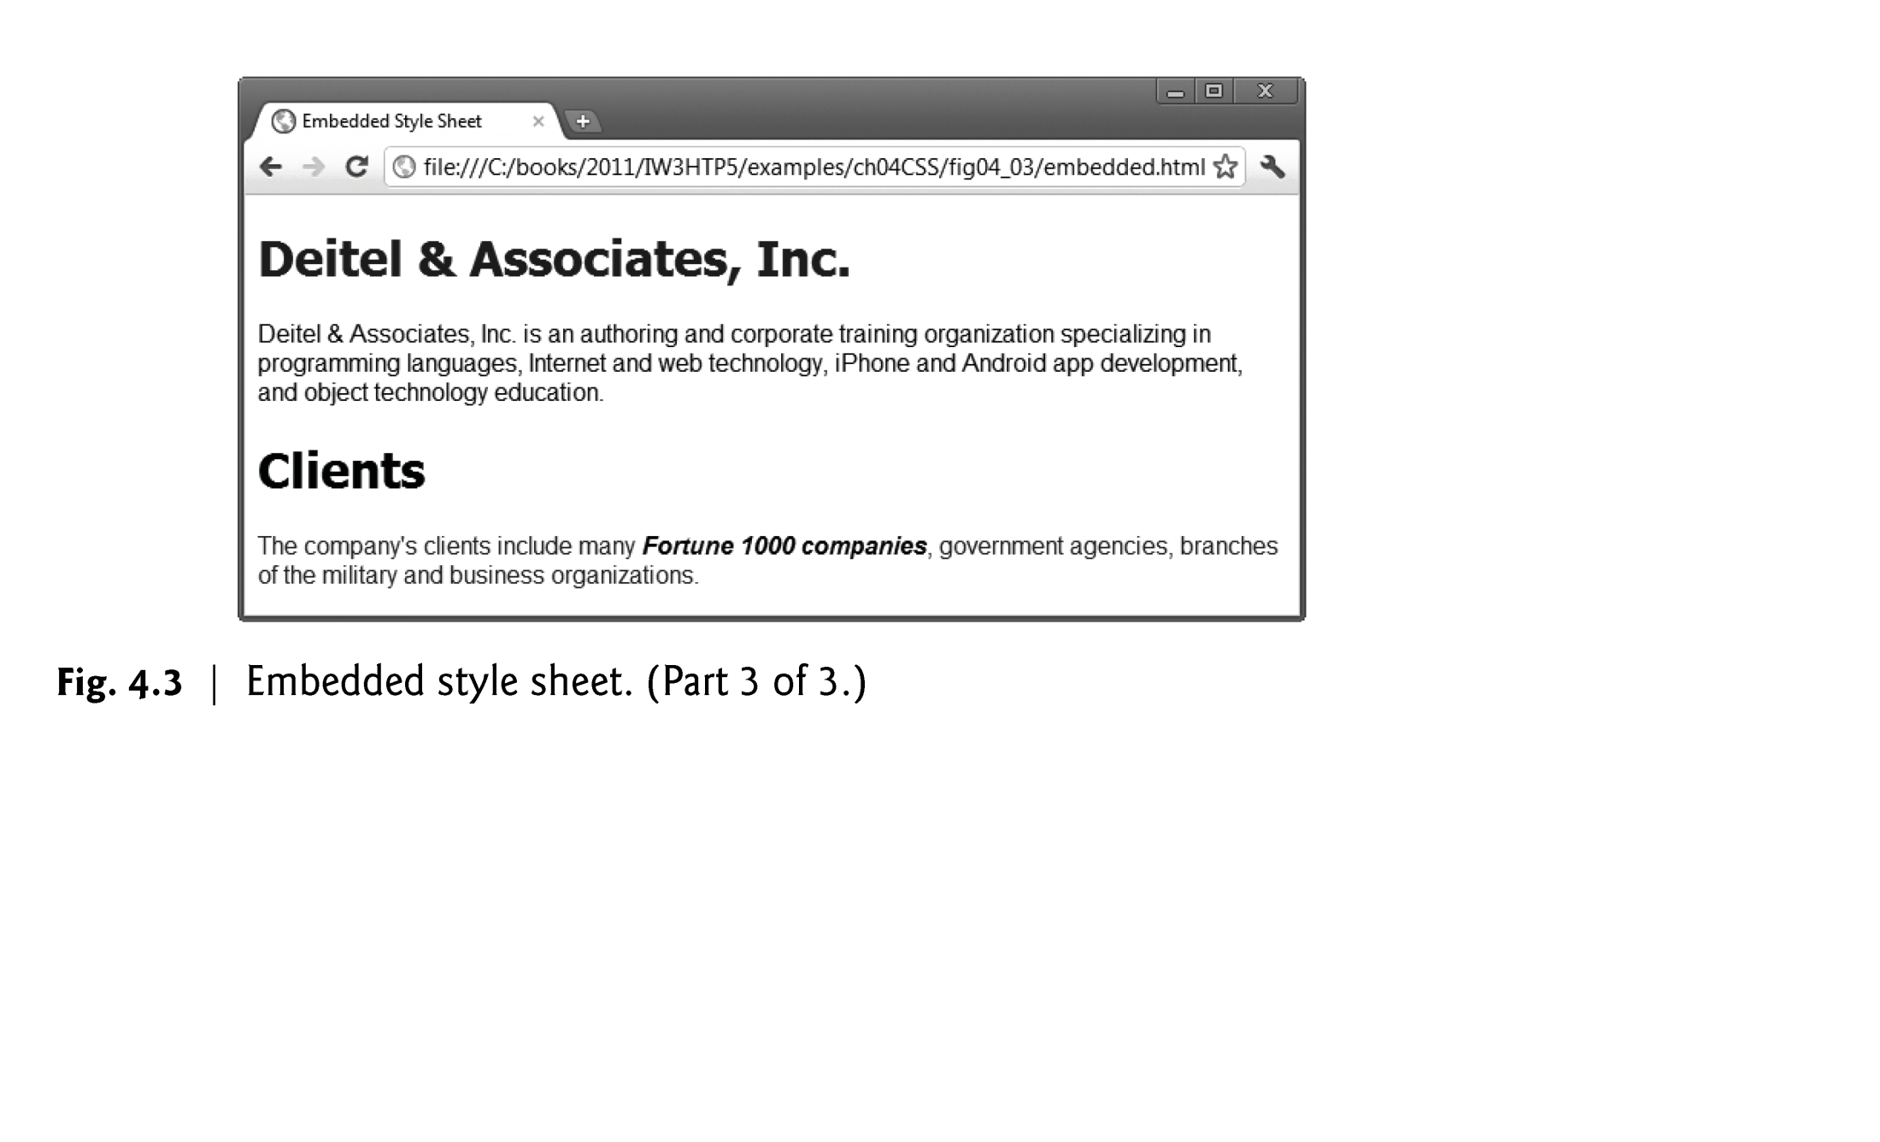

Slide 17
4.3 Embedded Style Sheets (cont.)
The style Element and MIME Types
Styles that are placed in a style element use selectors to apply style elements throughout the entire document
style element type attribute specifies the MIME type (the specific encoding format) of the style sheet. Style sheets use text/css.
Figure 4.4 lists common MIME types used in this book. For a complete list, visit:
www.w3schools.com/media/media_mimeref.asp

Slide 18
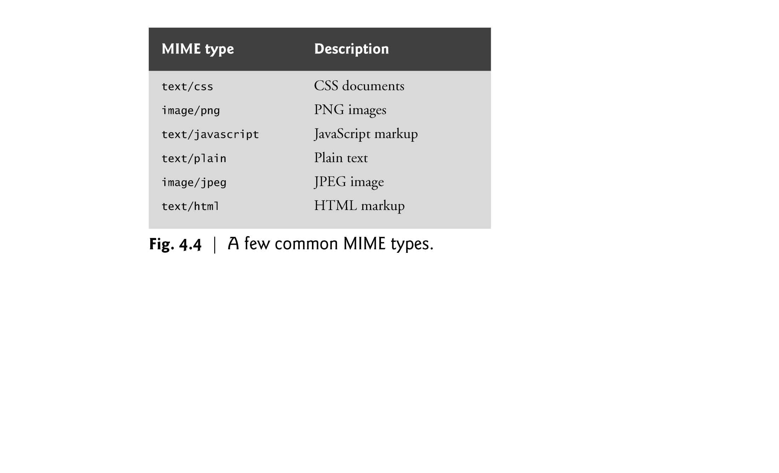

Slide 19
4.3 Embedded Style Sheets (cont.)
The style sheet’s body declares the CSS rules for the style sheet.
To achieve the separation between the CSS3 code and the HTML5 that it styles, we’ll use a CSS selector to specify the elements that will be styled according to a rule.
An em element indicates that its contents should be emphasized.
Each rule body in a style sheet is enclosed in curly braces ({ and }).

Slide 20
4.3 Embedded Style Sheets (Cont.)
font-weight property specifies the “boldness” of text. Possible values are:
bold
normal (the default)
bolder (bolder than bold text)
lighter (lighter than normal text)
Boldness also can be specified with multiples of 100, from 100 to 900 (e.g., 100, 200, …, 900). Text specified as normal is equivalent to 400, and bold text is equivalent to 700

Slide 21
4.3 Embedded Style Sheets (Cont.)
Style Classes
Style-class declarations are preceded by a period (.).
They define styles that can be applied to any element.
In this example, class special sets color to purple.
You can also declare id selectors.
If an element in your page has an id, you can declare a selector of the form #elementId to specify that element’s style.

Slide 22
5.3 Embedded Style Sheets (Cont.)
font-family Property
font-family property specifies the name of the font to use.
Generic font families allow authors to specify a type of font instead of a specific font, in case a browser does not support a specific font.

Slide 23
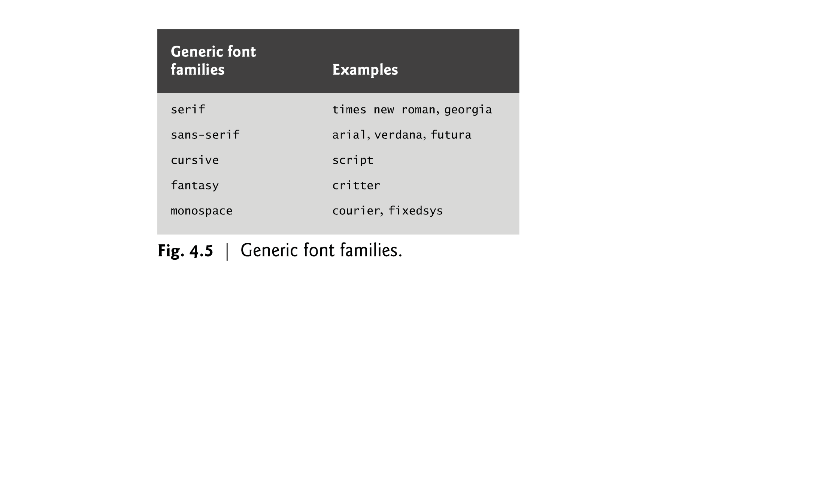

Slide 24
4.3 Embedded Style Sheets (Cont.)
font-size Property
font-size property specifies the size used to render the font.
You can specify a point size or a relative value such as xx-small, x-small, small, smaller, medium, large, larger, x-large and xx-large.
Relative font-size values are preferred over points, because an author does not know the specific measurements of each client’s display.
Relative values permit more flexible viewing of web pages.
For example, users can change font sizes the browser displays for readability.

Slide 25
4.3 Embedded Style Sheets (Cont.)
Applying a Style Class
In many cases, the styles applied to an element (the parent or ancestor element) also apply to the element’s nested elements (child or descendant elements).
Multiple values of one property can be set or inherited on the same element, so the browser must reduce them to one value for that property per element before they’re rendered.
We discuss the rules for resolving these conflicts in the next section.

Slide 26
5.4 Conflicting Styles
Styles may be defined by a user, an author or a user agent.
Styles cascade (and hence the term “Cascading Style Sheets”), or flow together, such that the ultimate appearance of elements on a page results from combining styles defined in several ways.
Styles defined by the user take precedence over styles defined by the user agent.
Styles defined by authors take precedence over styles defined by the user.
Most styles defined for parent elements are also inherited by child (nested) elements.

Slide 27
5.4 Conflicting Styles (Cont.)
text-decoration property applies decorations to text in an element
underline
overline
line-through
blink

Slide 28
5.4 Conflicting Styles (Cont.)
Figure 4.3 contains an example of inheritance in which a child em element inherits the font-size property from its parent p element.
However, in Fig. 4.3, the child em element has a color property that conflicts with (i.e., has a different value than) the color property of its parent p element.
Properties defined for child and descendant elements have a higher specificity than properties defined for parent and ancestor elements.
Conflicts are resolved in favor of properties with a higher specificity, so the child’s styles take precedence.
Figure 4.6 illustrates examples of inheritance and specificity.

Slide 29
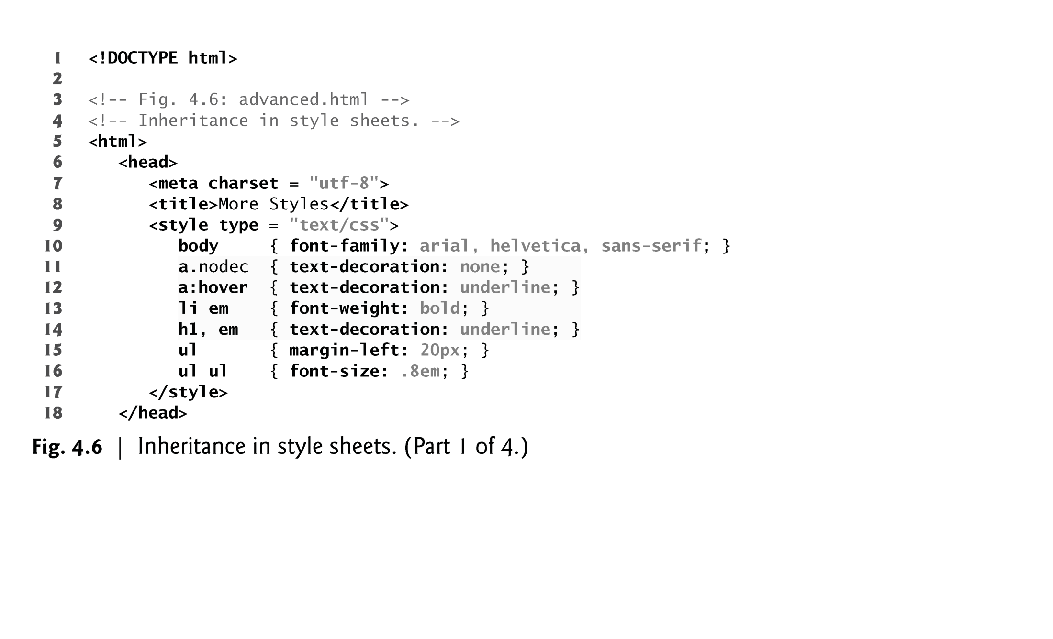

Slide 30
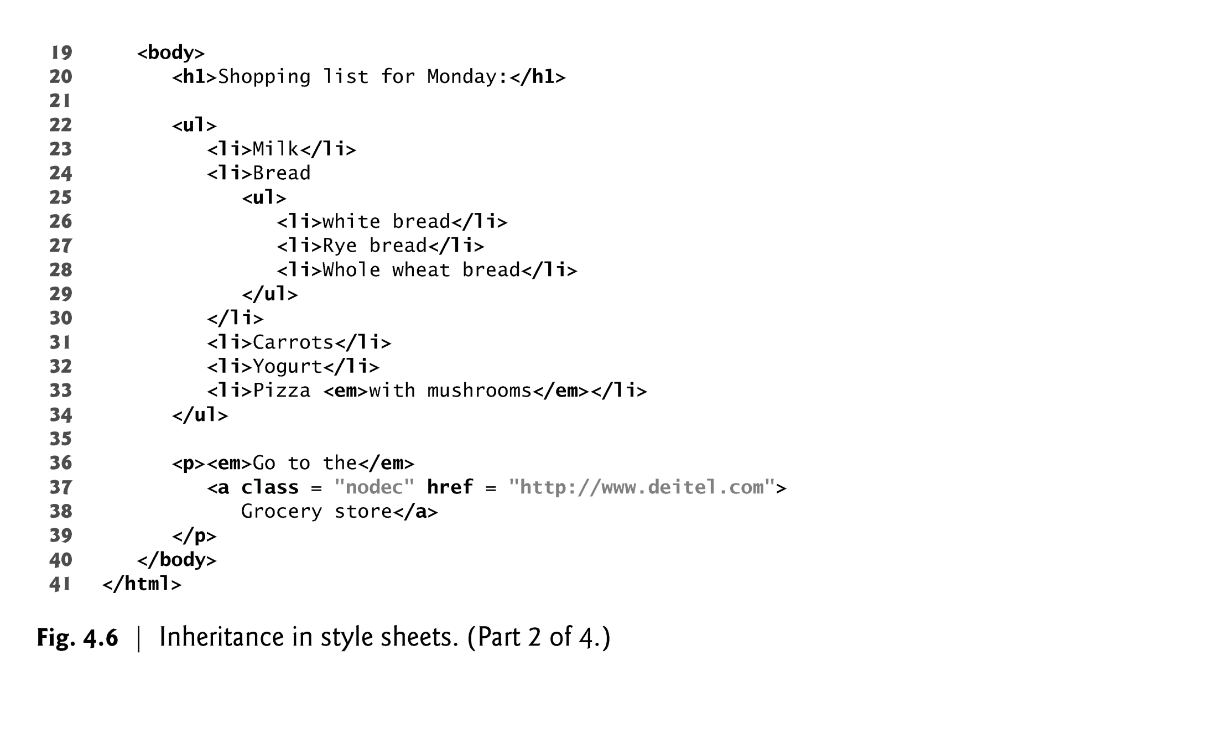

Slide 31
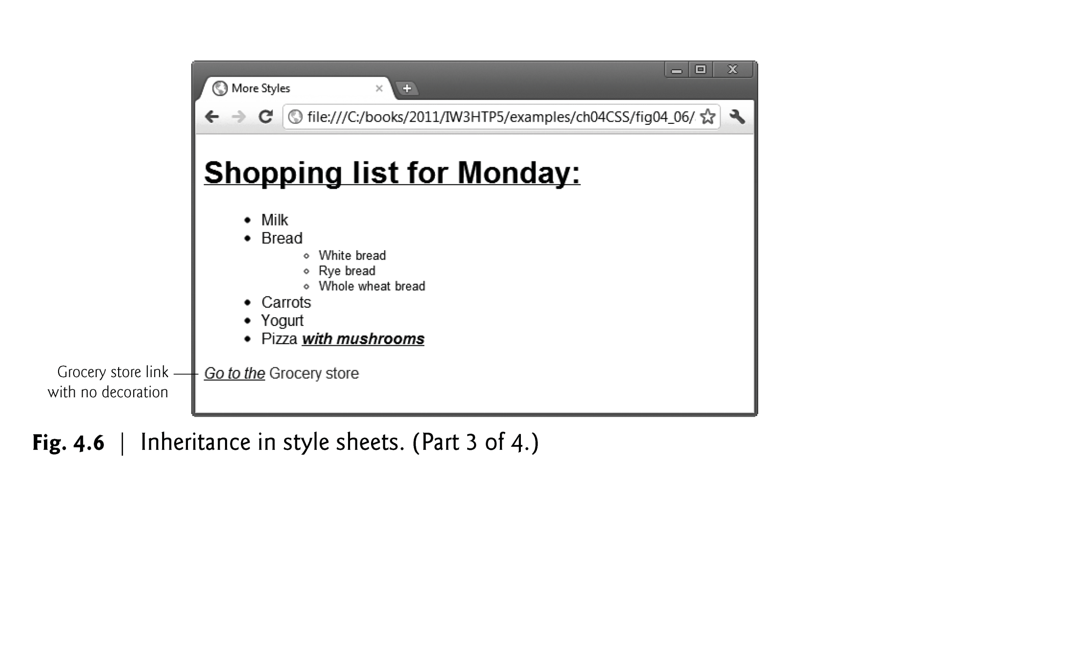

Slide 32
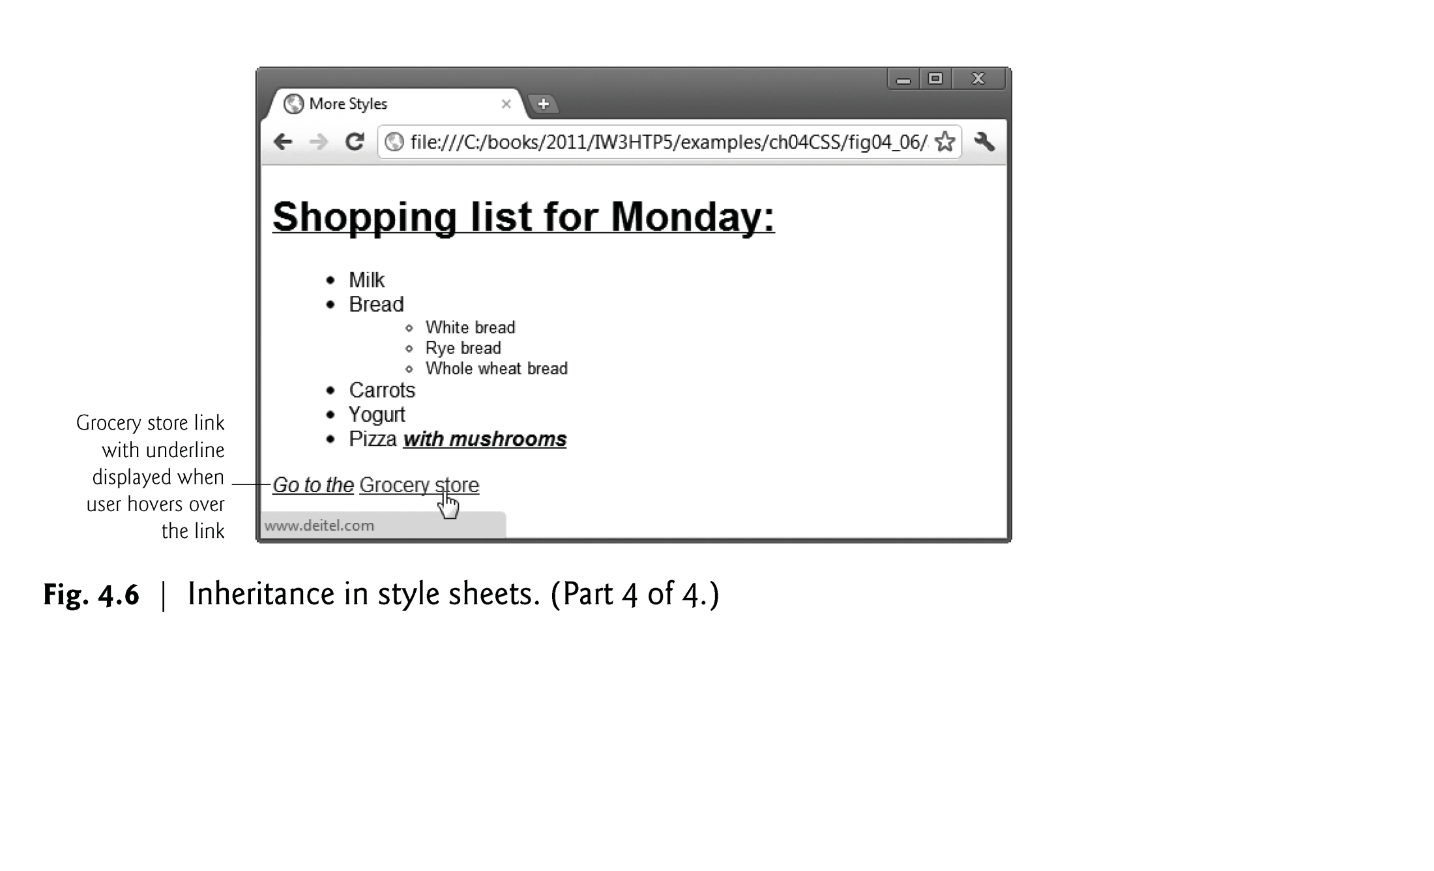

Slide 33
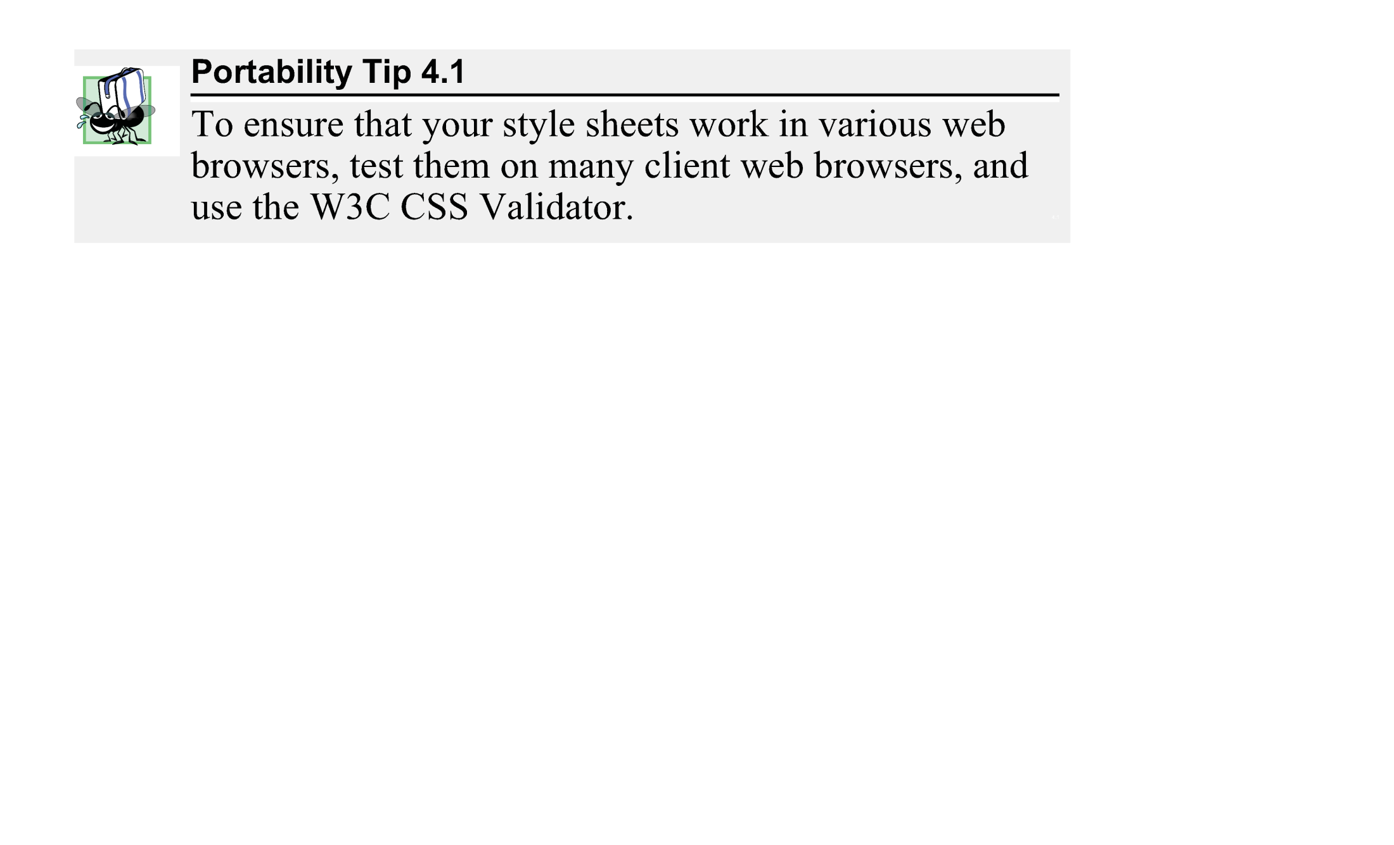

Slide 34
4.4 Conflicting Styles (Cont.)
Pseudoclasses give you access to content that’s not declared in the document.
hover pseudoclass is activated when the user moves the mouse cursor over an element.
a:link {color:#FF0000;
text-decoration:none;} /* unvisited link */ a:visited {color:#00FF00;} /* visited link */ a:hover {color:#FF00FF;
text-decoration:underline;
background-color:#FF704D;} /* mouse over link */ a:active {color:#0000FF;} /* selected link */

Slide 35
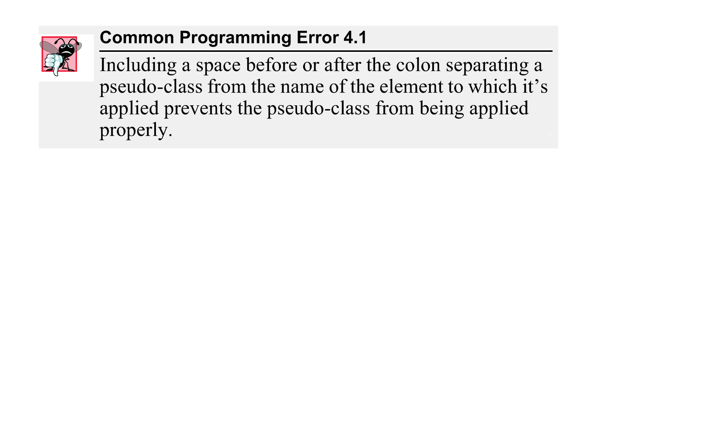

Slide 36
4.4 Conflicting Styles (Cont.)
Relative length measurements:
px (pixels – size varies depending on screen resolution)
em (usually the height of a font’s uppercase M)
ex (usually the height of a font’s lowercase x)
Percentages (of the font’s default size)
Absolute-length measurements (units that do not vary in size):
in (inches)
cm (centimeters)
mm (millimeters)
pt (points; 1 pt = 1/72 in)
pc (picas; 1 pc = 12 pt)

Slide 37
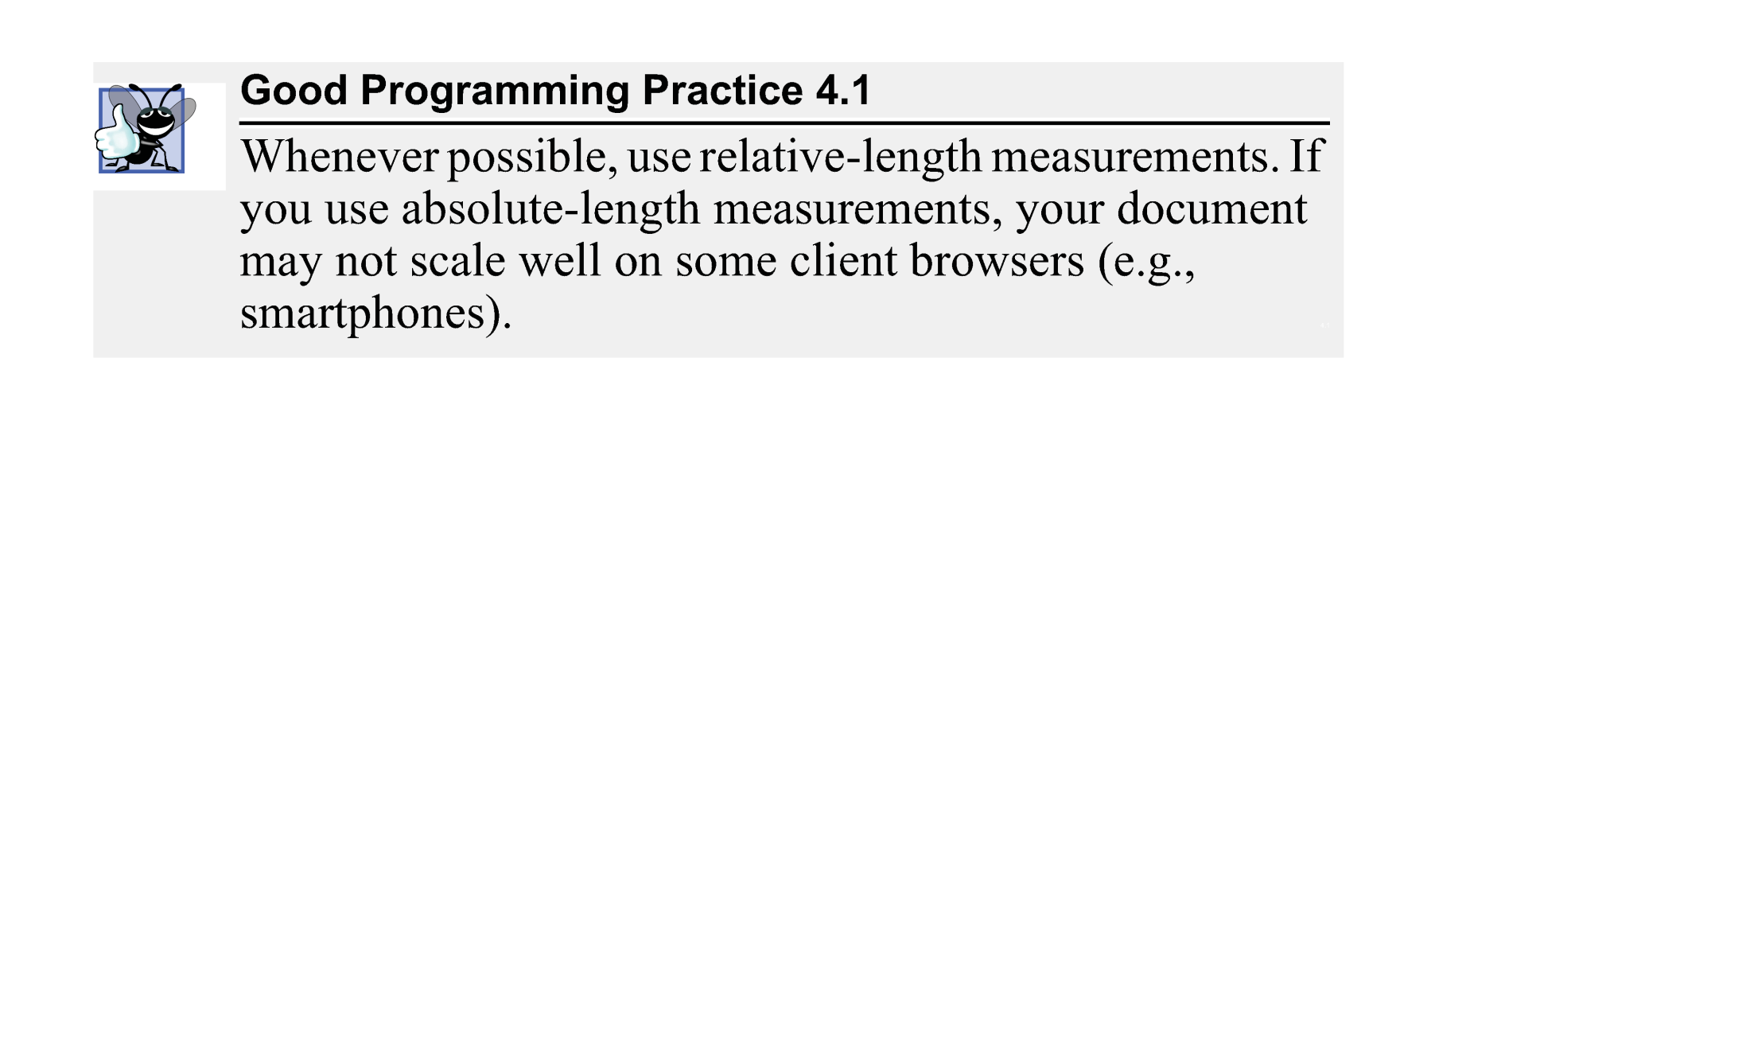

Slide 38
4.5 Linking External Style Sheets
External style sheets are separate documents that contain only CSS rules.
Help create a uniform look for a website
Separate pages can all use the same styles.
Modifying a single style-sheet file makes changes to styles across an entire website (or to a portion of one).
When changes to the styles are required, you need to modify only a single CSS file to make style changes across all the pages that use those styles. This concept is sometimes known as skinning.

Slide 39
4.5 Linking External Style Sheets (Cont.)
Figure 4.7 presents an external style sheet.
CSS comments may be placed in any type of CSS code (i.e., inline styles, embedded style sheets and external style sheets) and always start with /* and end with */.

Slide 40
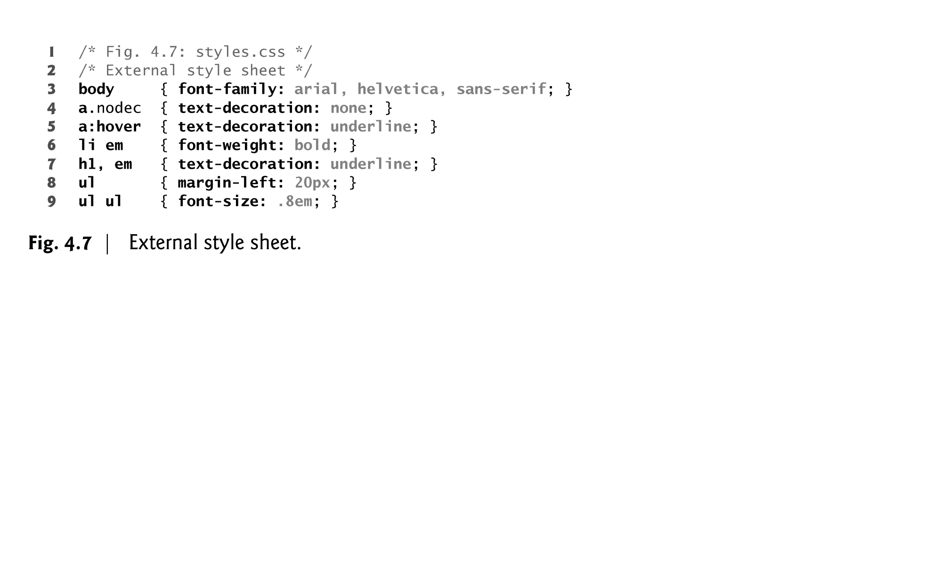

Slide 41
4.5 Linking External Style Sheets (Cont.)
Figure 4.8 contains an HTML5 document that references the external style sheet.
link element
Uses rel attribute to specify a relationship between two documents
rel attribute declares the linked document to be a stylesheet for the document
type attribute specifies the MIME type of the related document
href attribute provides the URL for the document containing the style sheet

Slide 42
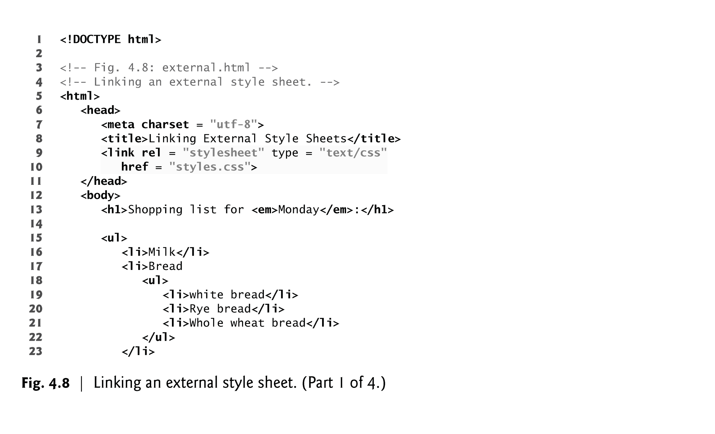

Slide 43
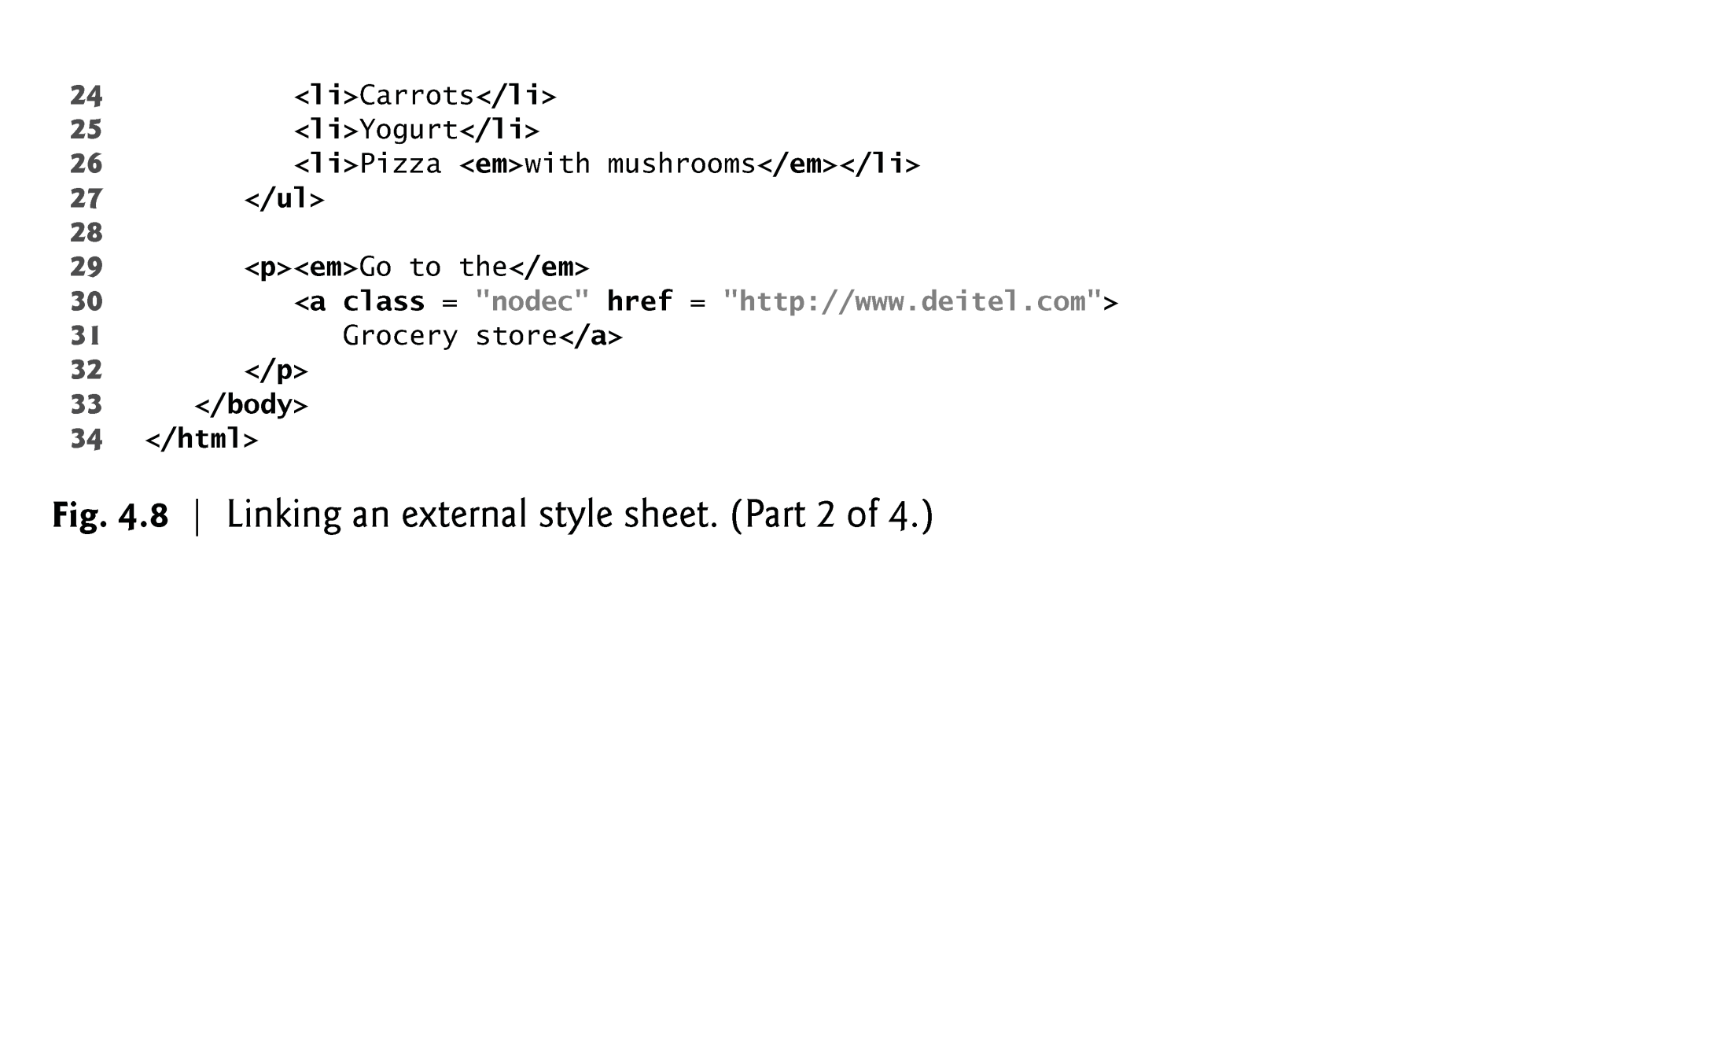

Slide 44
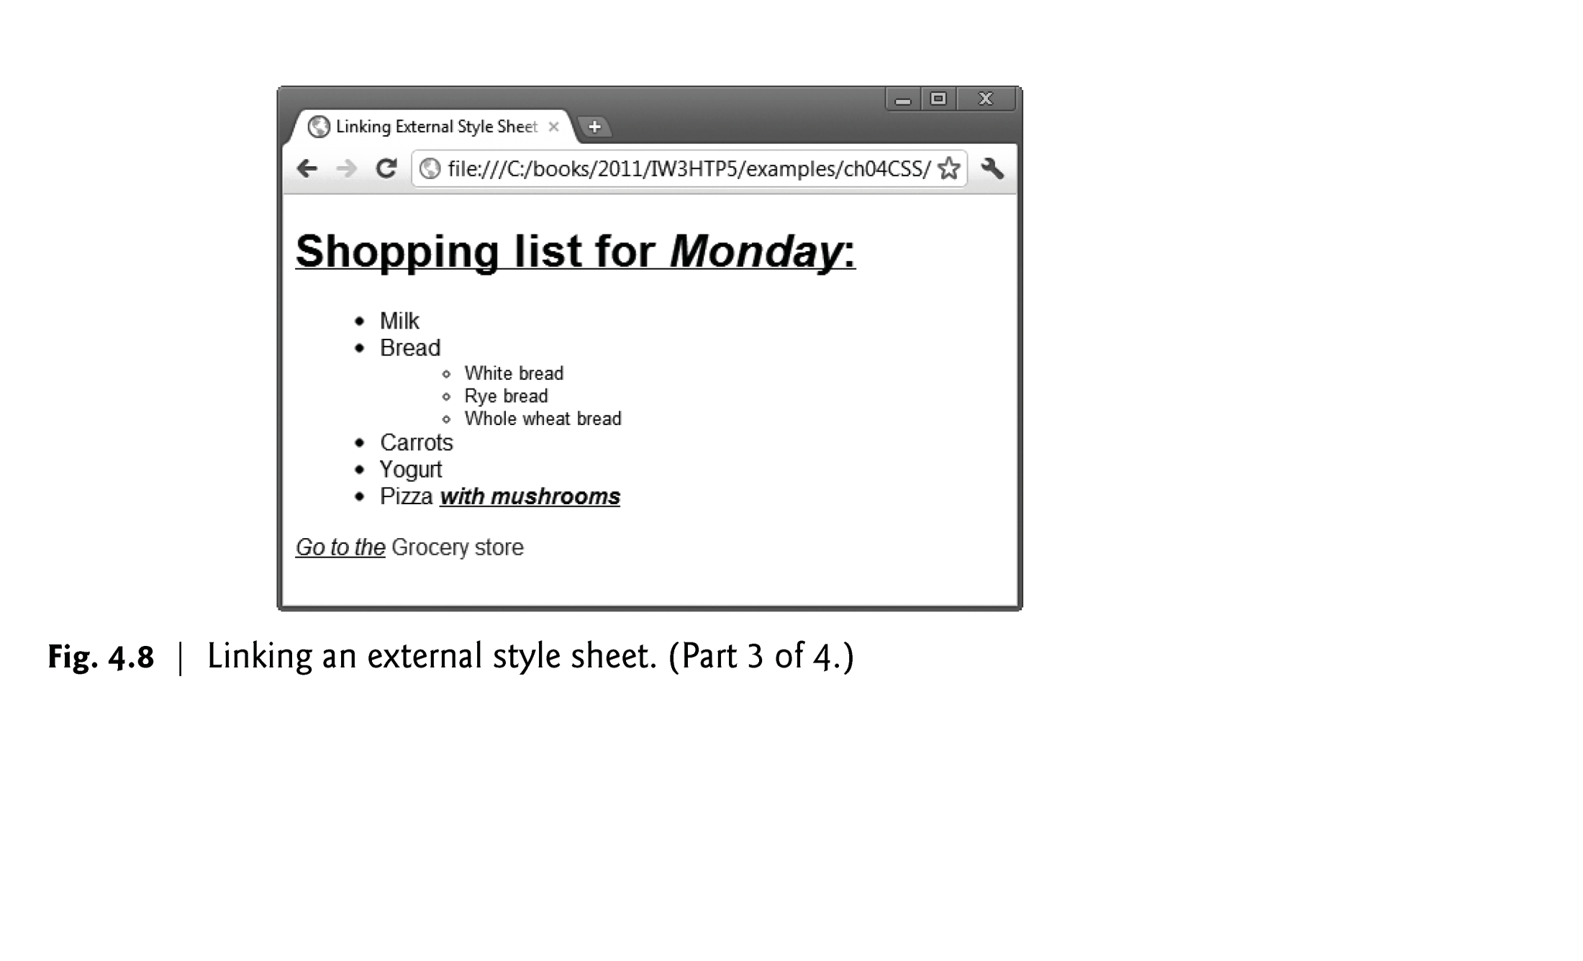

Slide 45
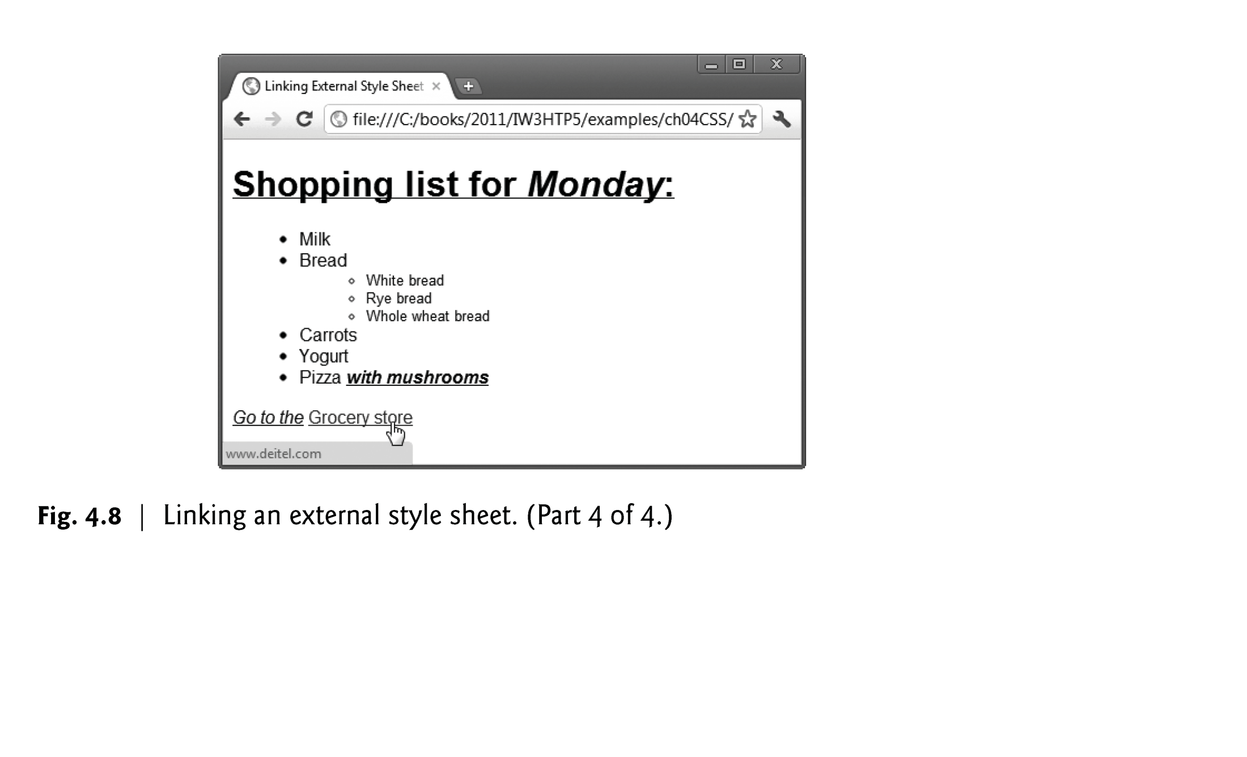

Slide 46
4.6 Positioning Elements: Absolute Positioning, z-index
CSS position property
Allows absolute positioning, which provides greater control over where on a page elements reside
Normally, elements are positioned on the page in the order in which they appear in the HTML5 document
Specifying an element’s position as absolute removes it from the normal flow of elements on the page and positions it according to distance from the top, left, right or bottom margin of its parent element

Slide 47
Position
Static
is not positioned in any special way; it is always positioned according to the normal flow of the page
Default
Relative
is positioned relative to its normal position
Fixed
is positioned relative to the viewport, which means it always stays in the same place even if the page is scrolled.
Absolute
is positioned relative to the nearest positioned ancestor (instead of positioned relative to the viewport, like fixed).
if an absolute positioned element has no positioned ancestors, it uses the document body, and moves along with page scrolling.
Sticky
is positioned based on the user's scroll position.

Slide 48
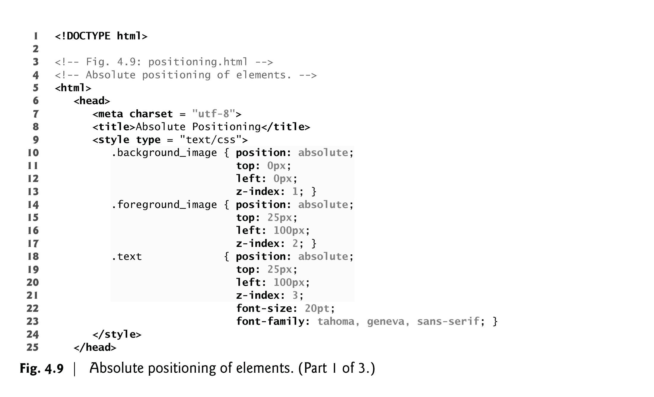

Slide 49
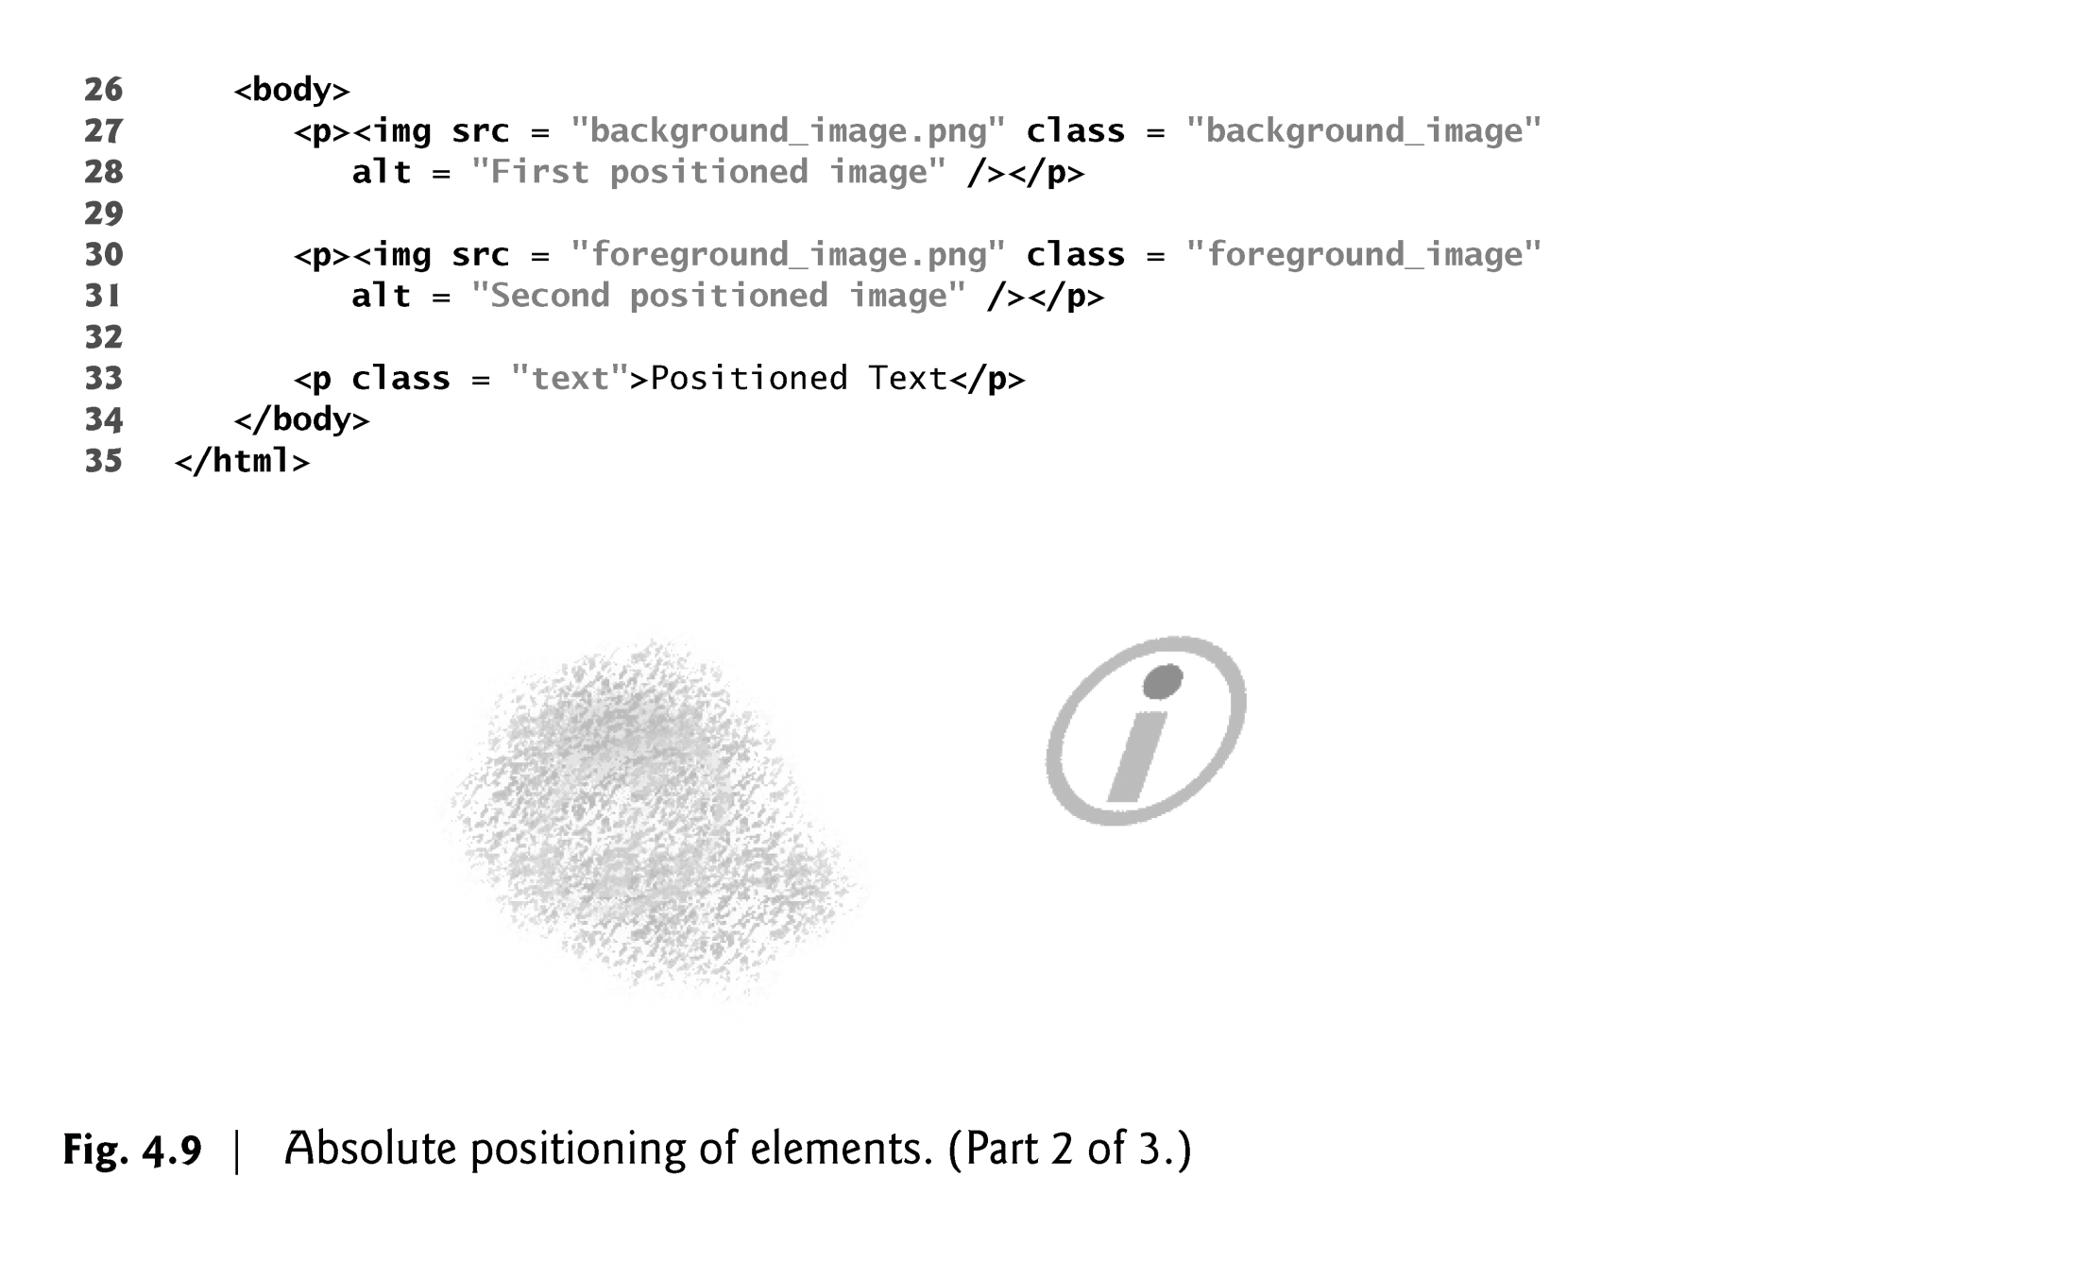

Slide 50
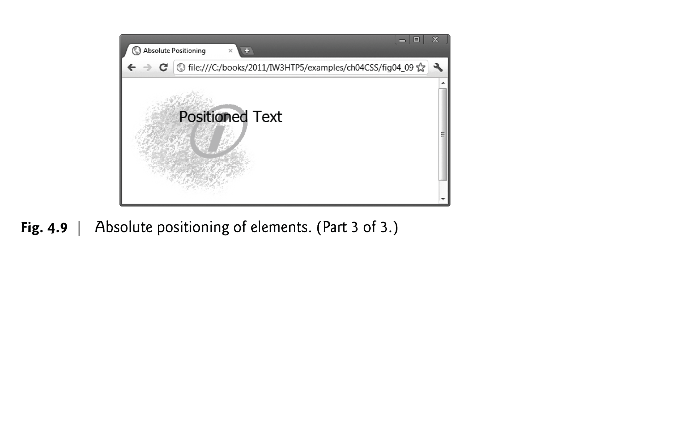

Slide 51
4.6 Positioning Elements: Absolute Positioning, z-index (Cont.)
The z-index property allows a developer to layer overlapping elements
Elements that have higher z-index values are displayed in front of elements with lower z-index values

Slide 52
4.7 Positioning Elements: Relative Positioning, span
Figure 4.10 demonstrates relative positioning, in which elements are positioned relative to other elements.

Slide 53
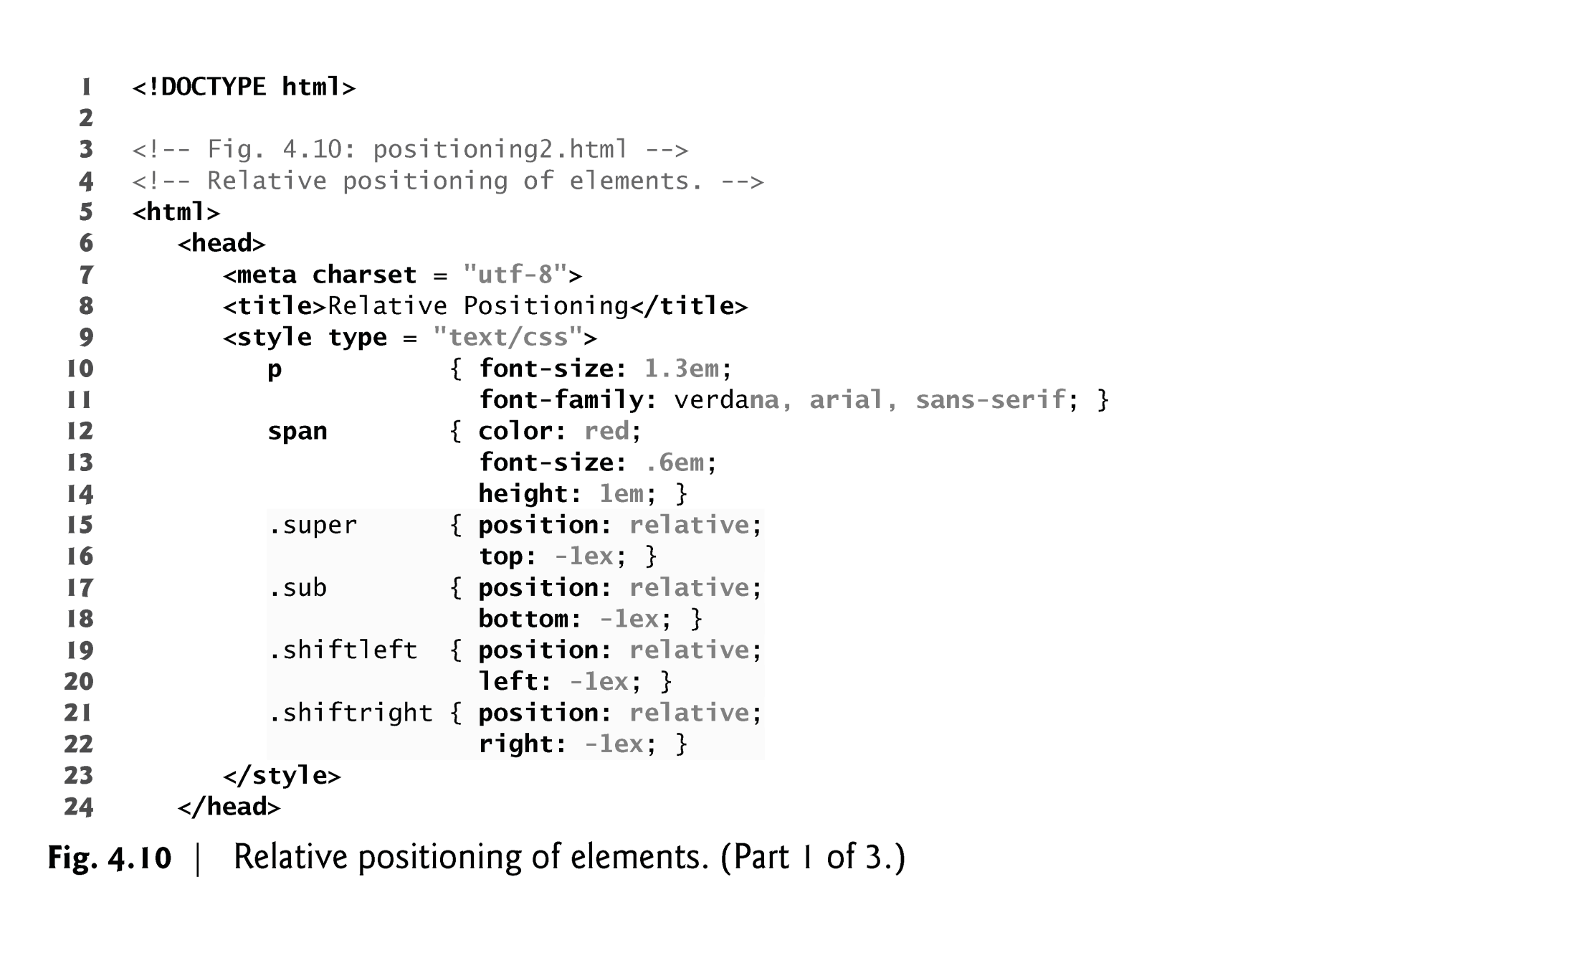

Slide 54
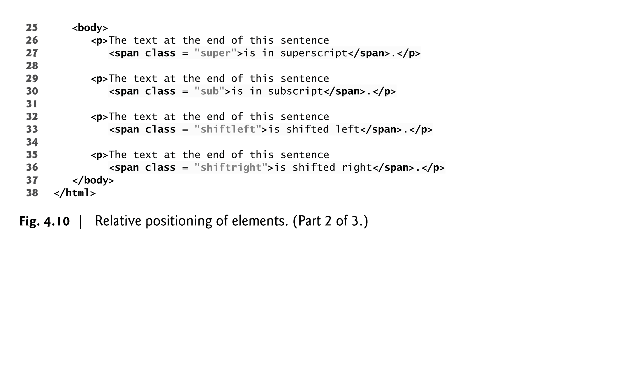

Slide 55
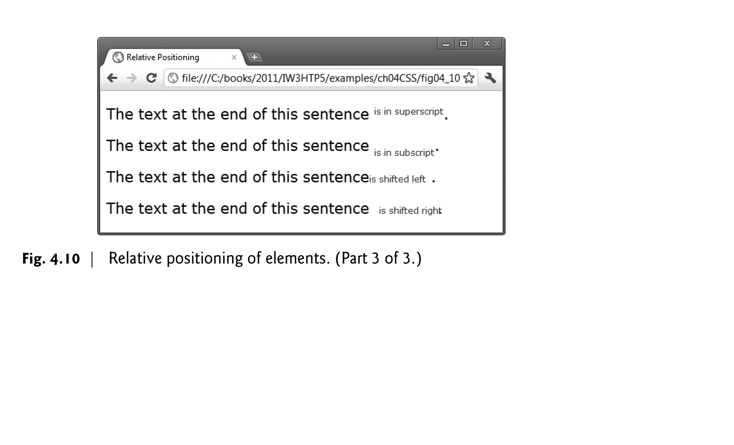

Slide 56
4.7 Positioning Elements: Relative Positioning, span (Cont.)
Inline and Block-Level Elements
Inline-level elements
Do not change the flow of the document
Examples:
img
a
em
strong
span
- Grouping element
- Does not apply any formatting to its contents
- Creates a container for CSS rules or id attributes to be applied to a section

Slide 57
4.7 Positioning Elements: Relative Positioning, span (Cont.)
Block-level elements
Displayed on their own line
Have virtual boxes around them
Examples:
p
all headings (h1 through h6)
div
- a grouping element like span

Slide 58
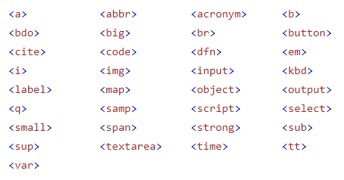
Other inline-level elements

Slide 59
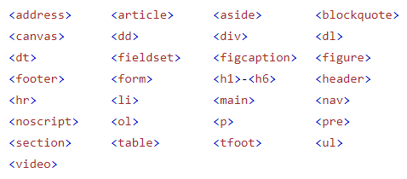
Other Block-level elements

Slide 60
display를 바꾸는 법
속성 ‘display’의 값
inline
block
inline-block
none
Visibility
visibility: visible;
visibility: hidden;

Slide 61
id와 id를 이용한 css 정의
id 표기법
<div id="boardBox">
<label>에서 활용
<label for="logid"><img src="images/main/title_id.gif" alt="아이디" /></label>
id를 이용한 CSS 정의
#boardBox h3{float:left;}
#boardBox ul {position:absolute; width:100%; top:45px;
left:0;}

Slide 62
4.8 Backgrounds
CSS can control the backgrounds of block-level elements by adding:
Colors
Images
Figure 4.11 adds a corporate logo to the bottom-right corner of the document. This logo stays fixed in the corner even when the user scrolls up or down the screen.

Slide 63
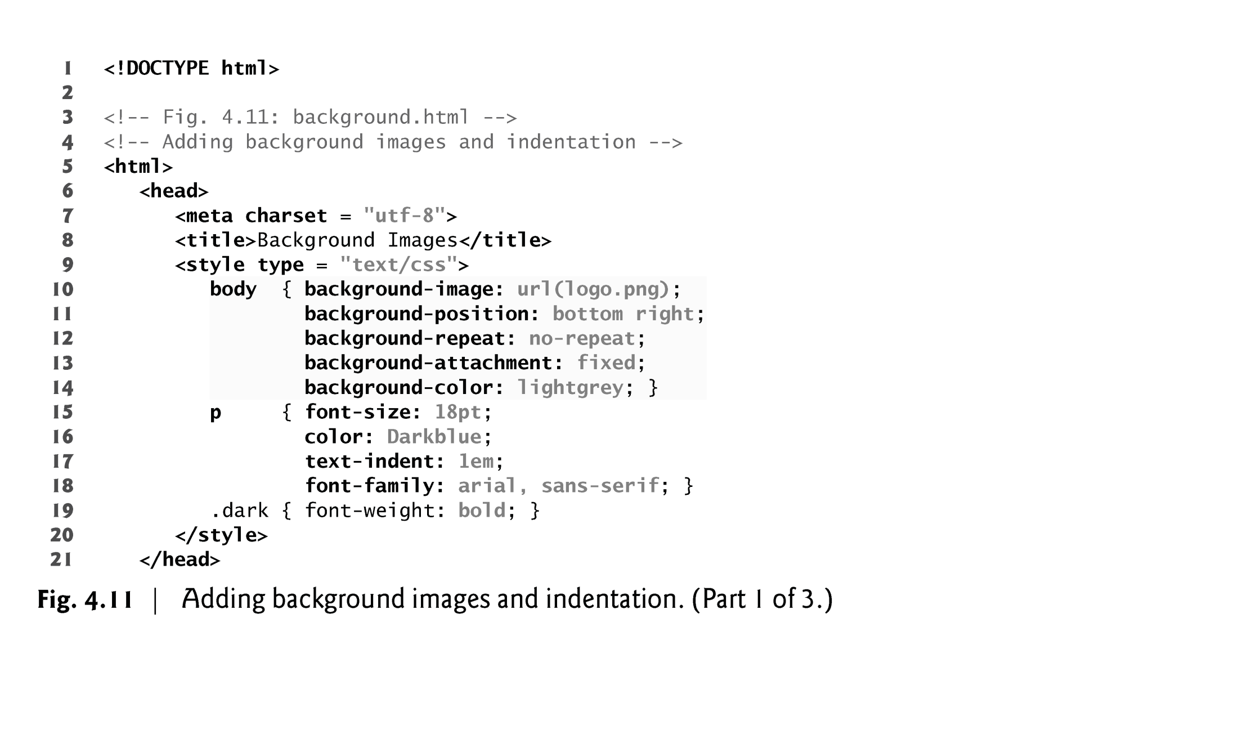

Slide 64
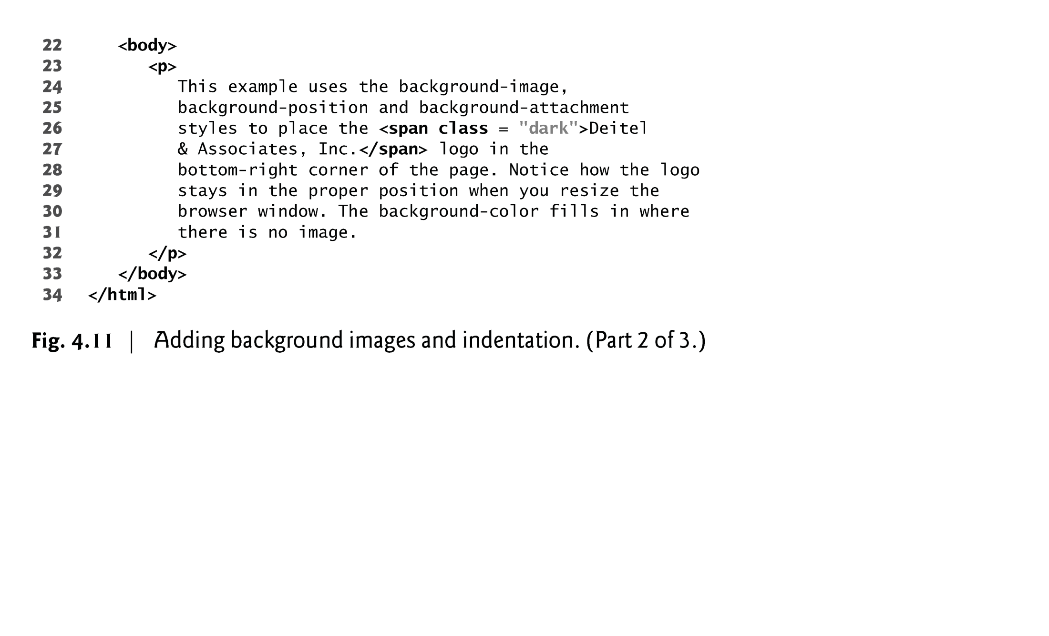

Slide 65
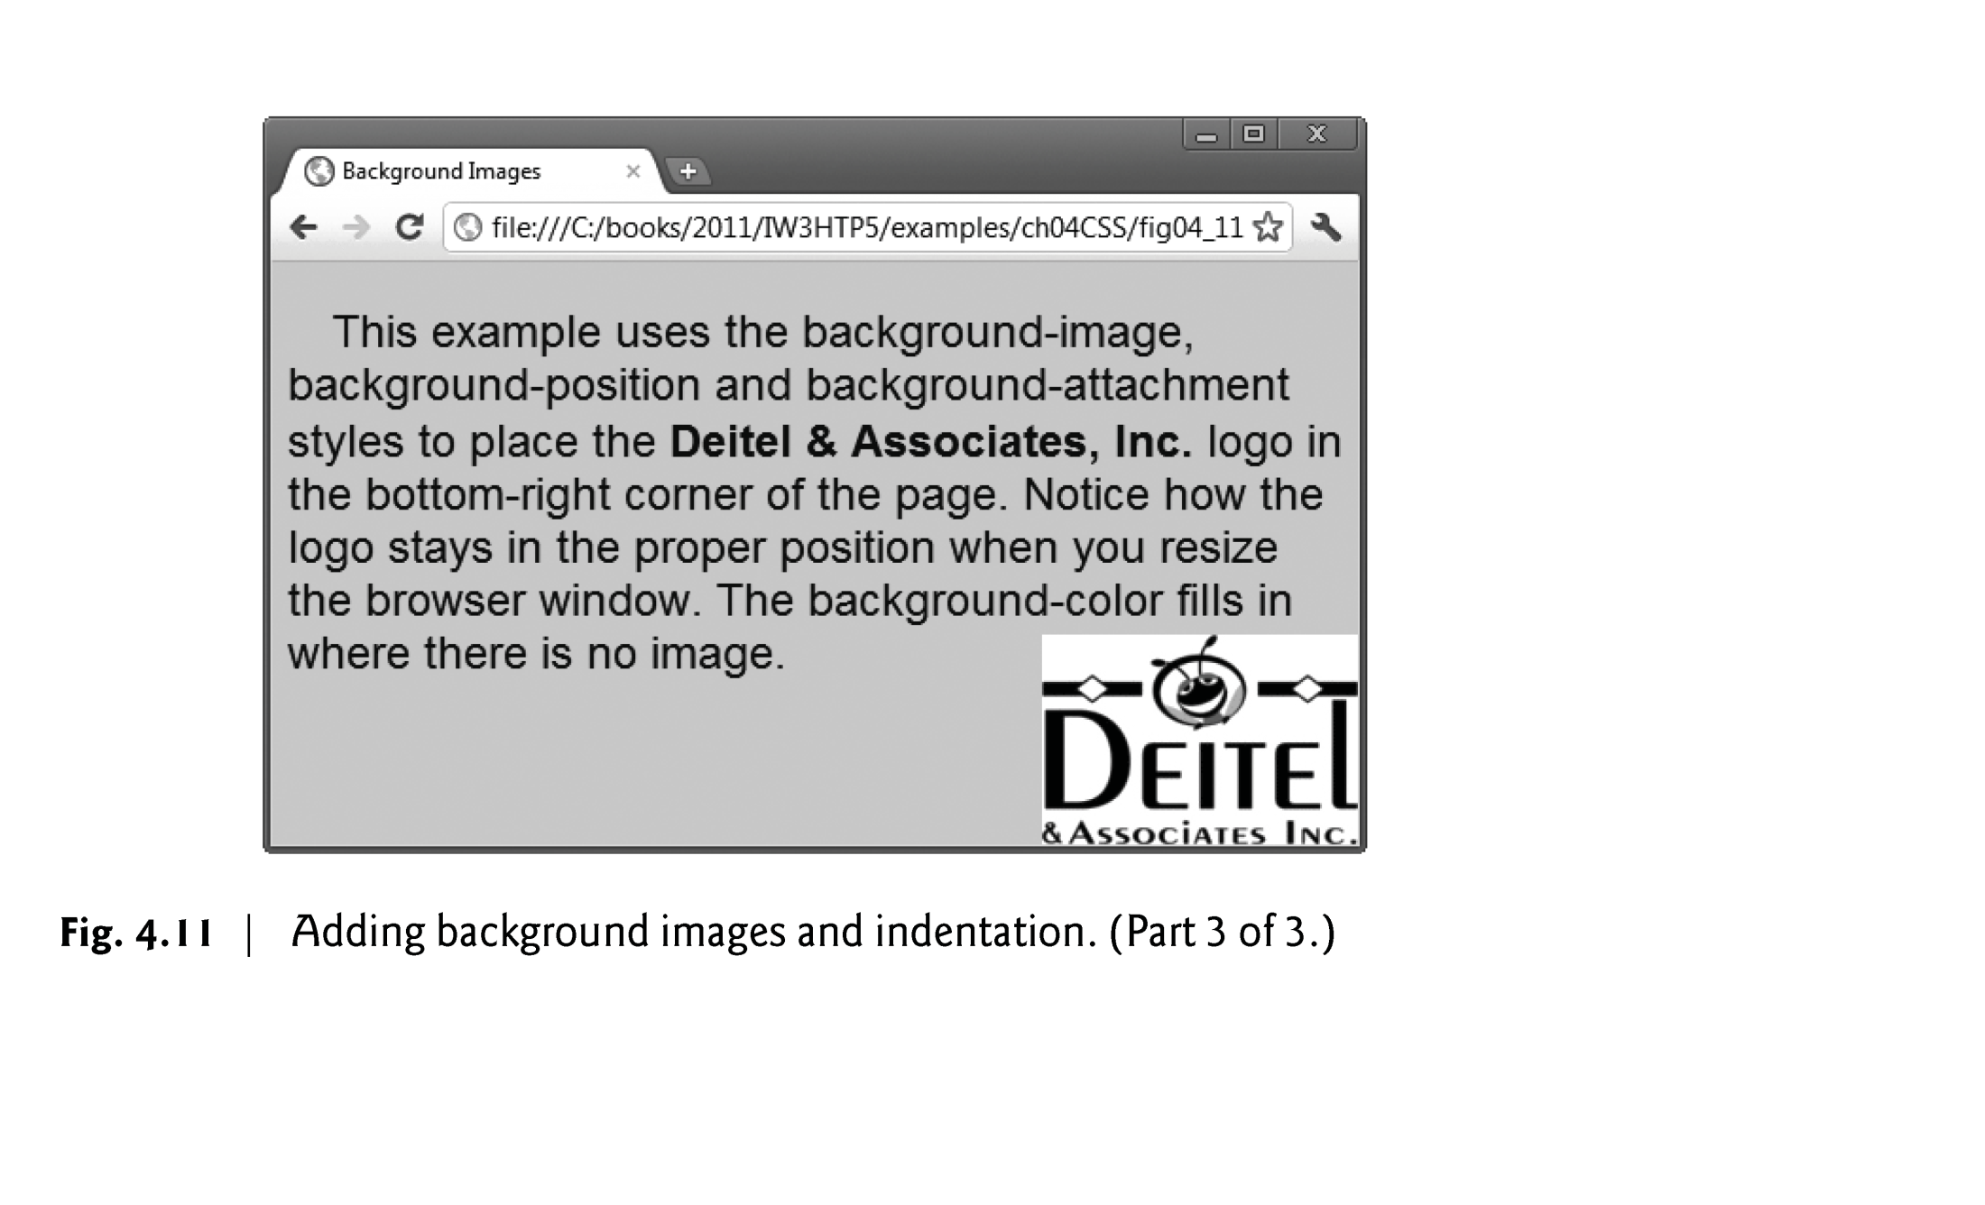

Slide 66
4.8 Backgrounds (Cont.)
background-image Property
Specifies the URL of the image, in the format url(fileLocation)
background-position Property
Places the image on the page using the values top, bottom, center, left and right individually or in combination for vertical and horizontal positioning. You can also position by using lengths

Slide 67
4.8 Backgrounds (Cont.)
background-repeat Property
background-repeat property controls the tiling of the background image
Setting the tiling to no-repeat displays one copy of the background image on screen
Setting to repeat (the default) tiles the image vertically and horizontally
Setting to repeat-x tiles the image only horizontally
Setting to repeat-y tile the image only vertically

Slide 68
4.8 Backgrounds (Cont.)
background-attachment: fixed Property
Fixes the image in the position specified by background-position.
Scrolling the browser window will not move the image from its set position.
The default value, scroll, moves the image as the user scrolls the window

Slide 69
4.8 Backgrounds (Cont.)
text-indent Property
Indents the first line of text in the element by the specified amount
font-style Property
Allows you to set text to none, italic or oblique

Slide 70
4.9 Element Dimensions
Figure 4.12 demonstrates how to set the dimensions of elements.

Slide 71
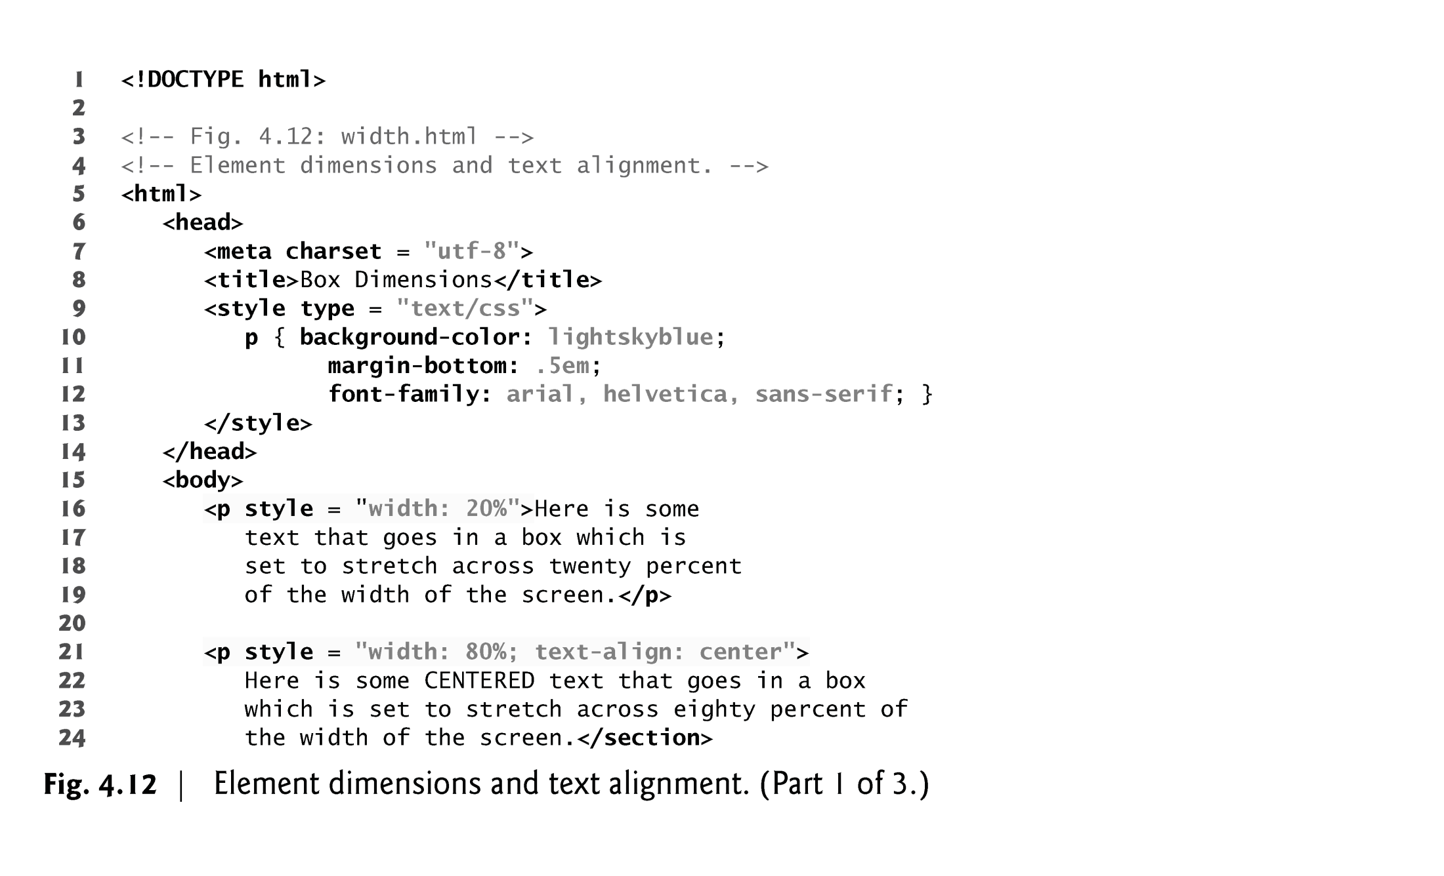

Slide 72
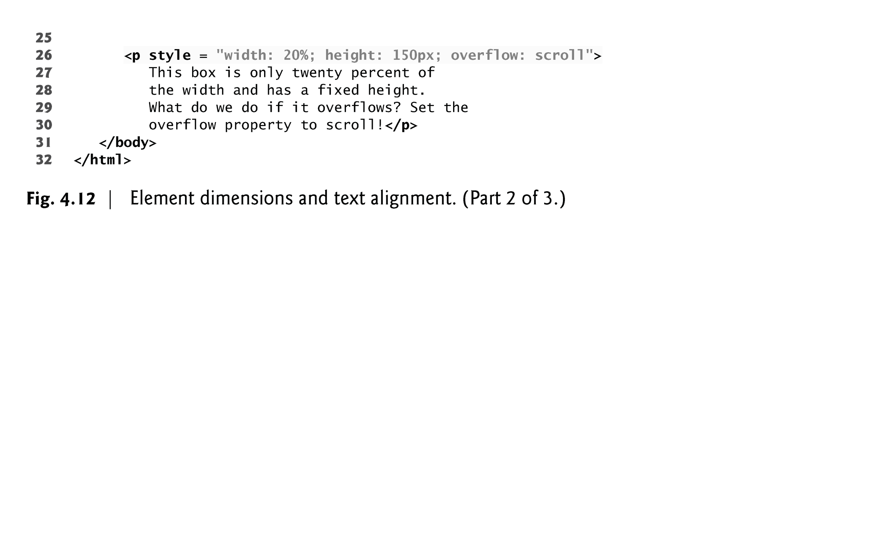

Slide 73
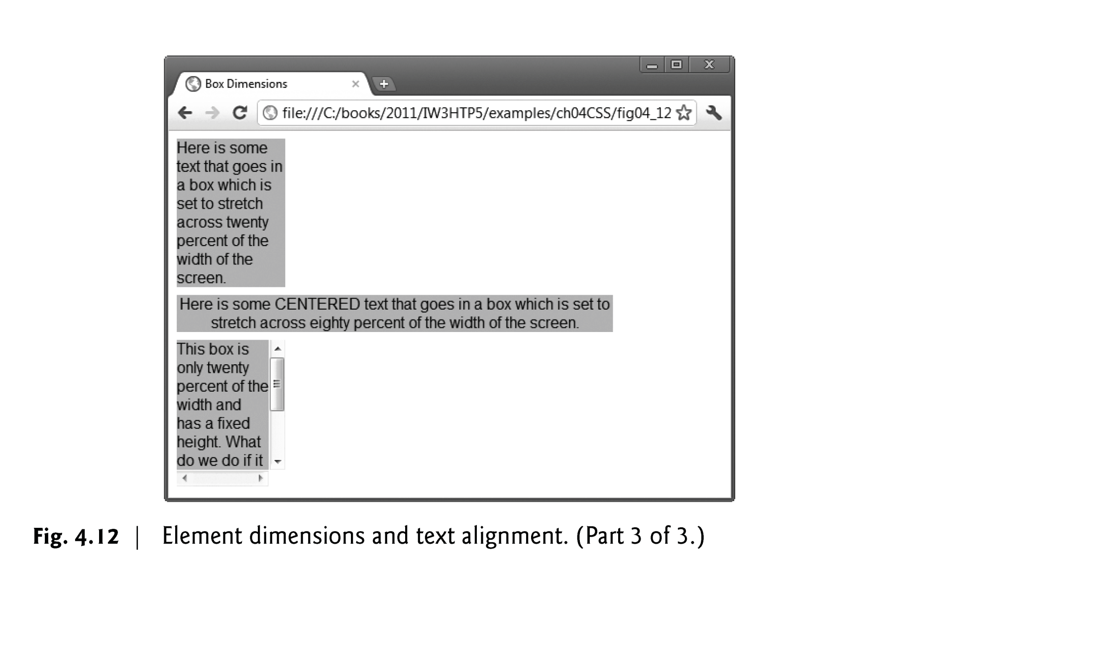

Slide 74
4.9 Element Dimensions
Specifying the width and height of an Element
Dimensions of elements on a page can be set with CSS by using properties height and width
Their values can be relative or absolute
text-align Property
Text in an element can be centered using text-align: center; other values for the text-align property are left and right

Slide 75
4.9 Element Dimensions (Cont.)
overflow Property and Scroll Bars
Problem with setting both vertical and horizontal dimensions of an element
Content might sometimes exceed the set boundaries, in which case the element must be made large enough for all the content to fit
Can set the overflow property to scroll, which adds scroll bars if the text overflows the boundaries set for it

Slide 76
4.10 Box Model and Text Flow
Block-level HTML5 elements have a virtual box drawn around them based on the box model
When the browser renders an element using the box model, the content is surrounded by padding, a margin and a border.
Padding
The padding property determines the distance between the content inside an element and the edge of the element
Padding be set for each side of the box by using padding-top, padding-right, padding-left and padding-bottom
Margin
Determines the distance between the element’s edge and any outside text
Margins for individual sides of an element can be specified by using margin-top, margin-right, margin-left and margin-bottom

Slide 77
4.10 Box Model and Text Flow (Cont.)
Border
The border is controlled using the properties:
border-width
May be set to any of the CSS lengths or to the predefined value of thin, medium or thick
border-color
Sets the color used for the border
border-style
Options are: none, hidden, dotted, dashed, solid, double, groove, ridge, inset and outset

Slide 78
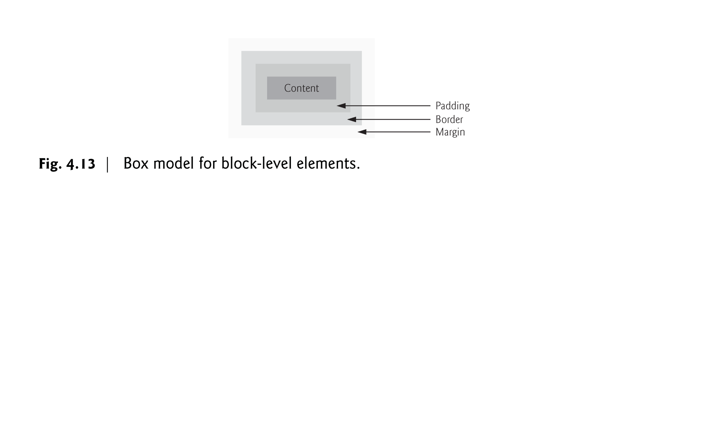

Slide 79
4.10 Box Model and Text Flow (Cont.)
CSS controls the border using three properties: border-width, border-color and border-style.
We illustrate these properties in Fig. 4.14.

Slide 80
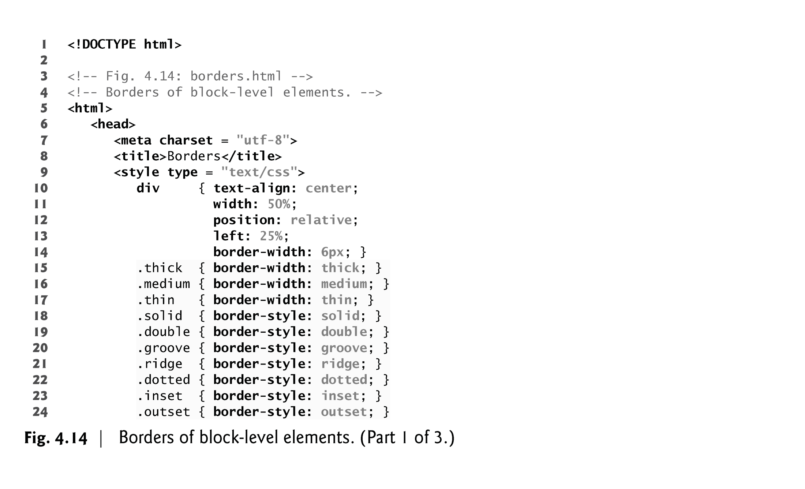

Slide 81
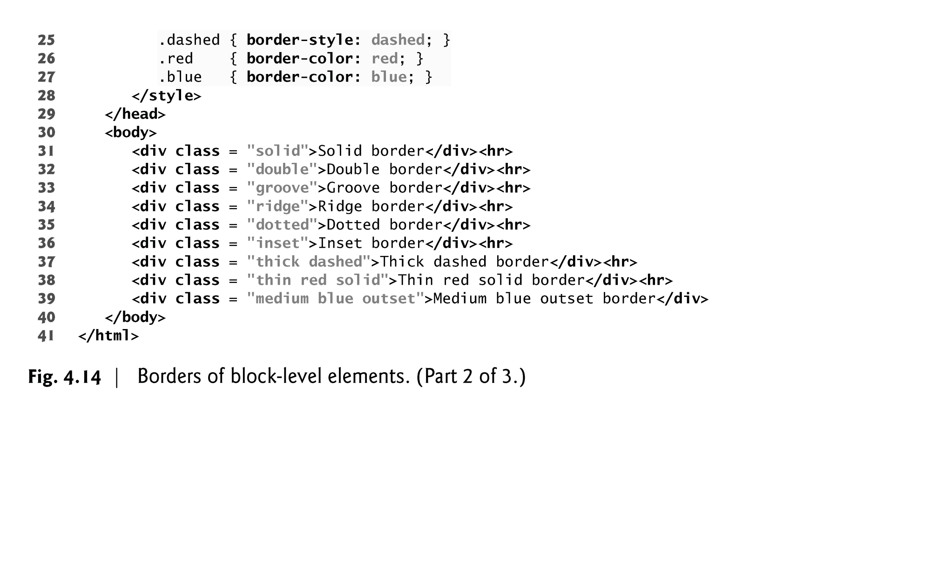

Slide 82
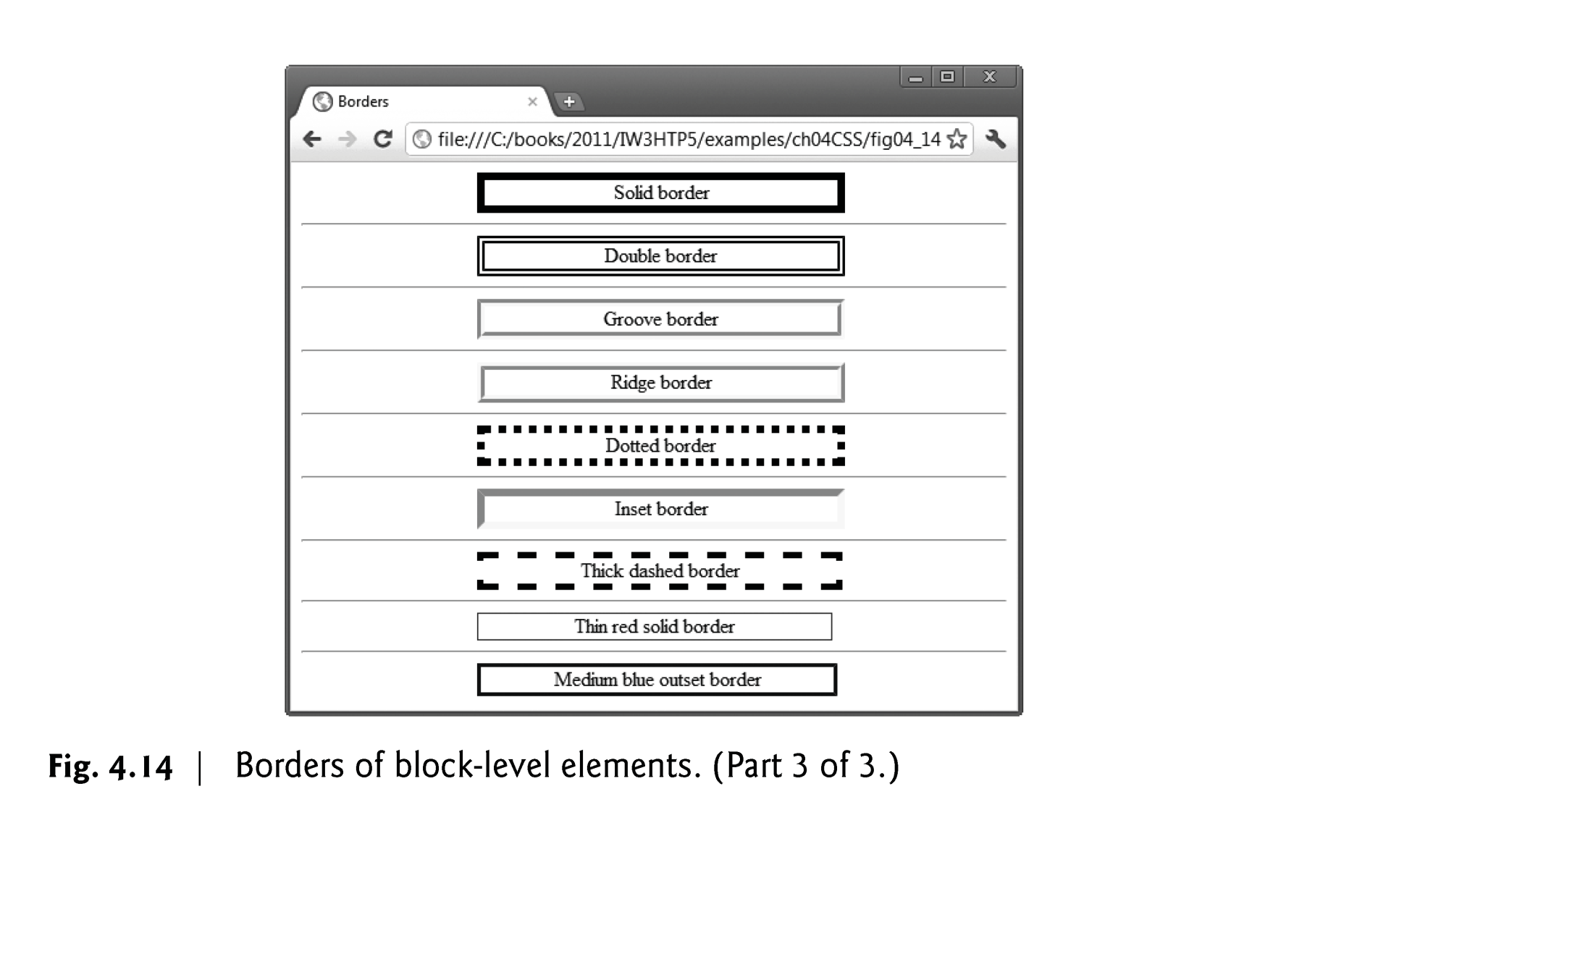

Slide 83
4.10 Box Model and Text Flow (Cont.)
Floating Elements
Floating allows you to move an element to one side of the screen; other content in the document then flows around the floated element.
Figure 4.15 demonstrates how floating elements and the box model can be used to control the layout of an entire page.

Slide 84
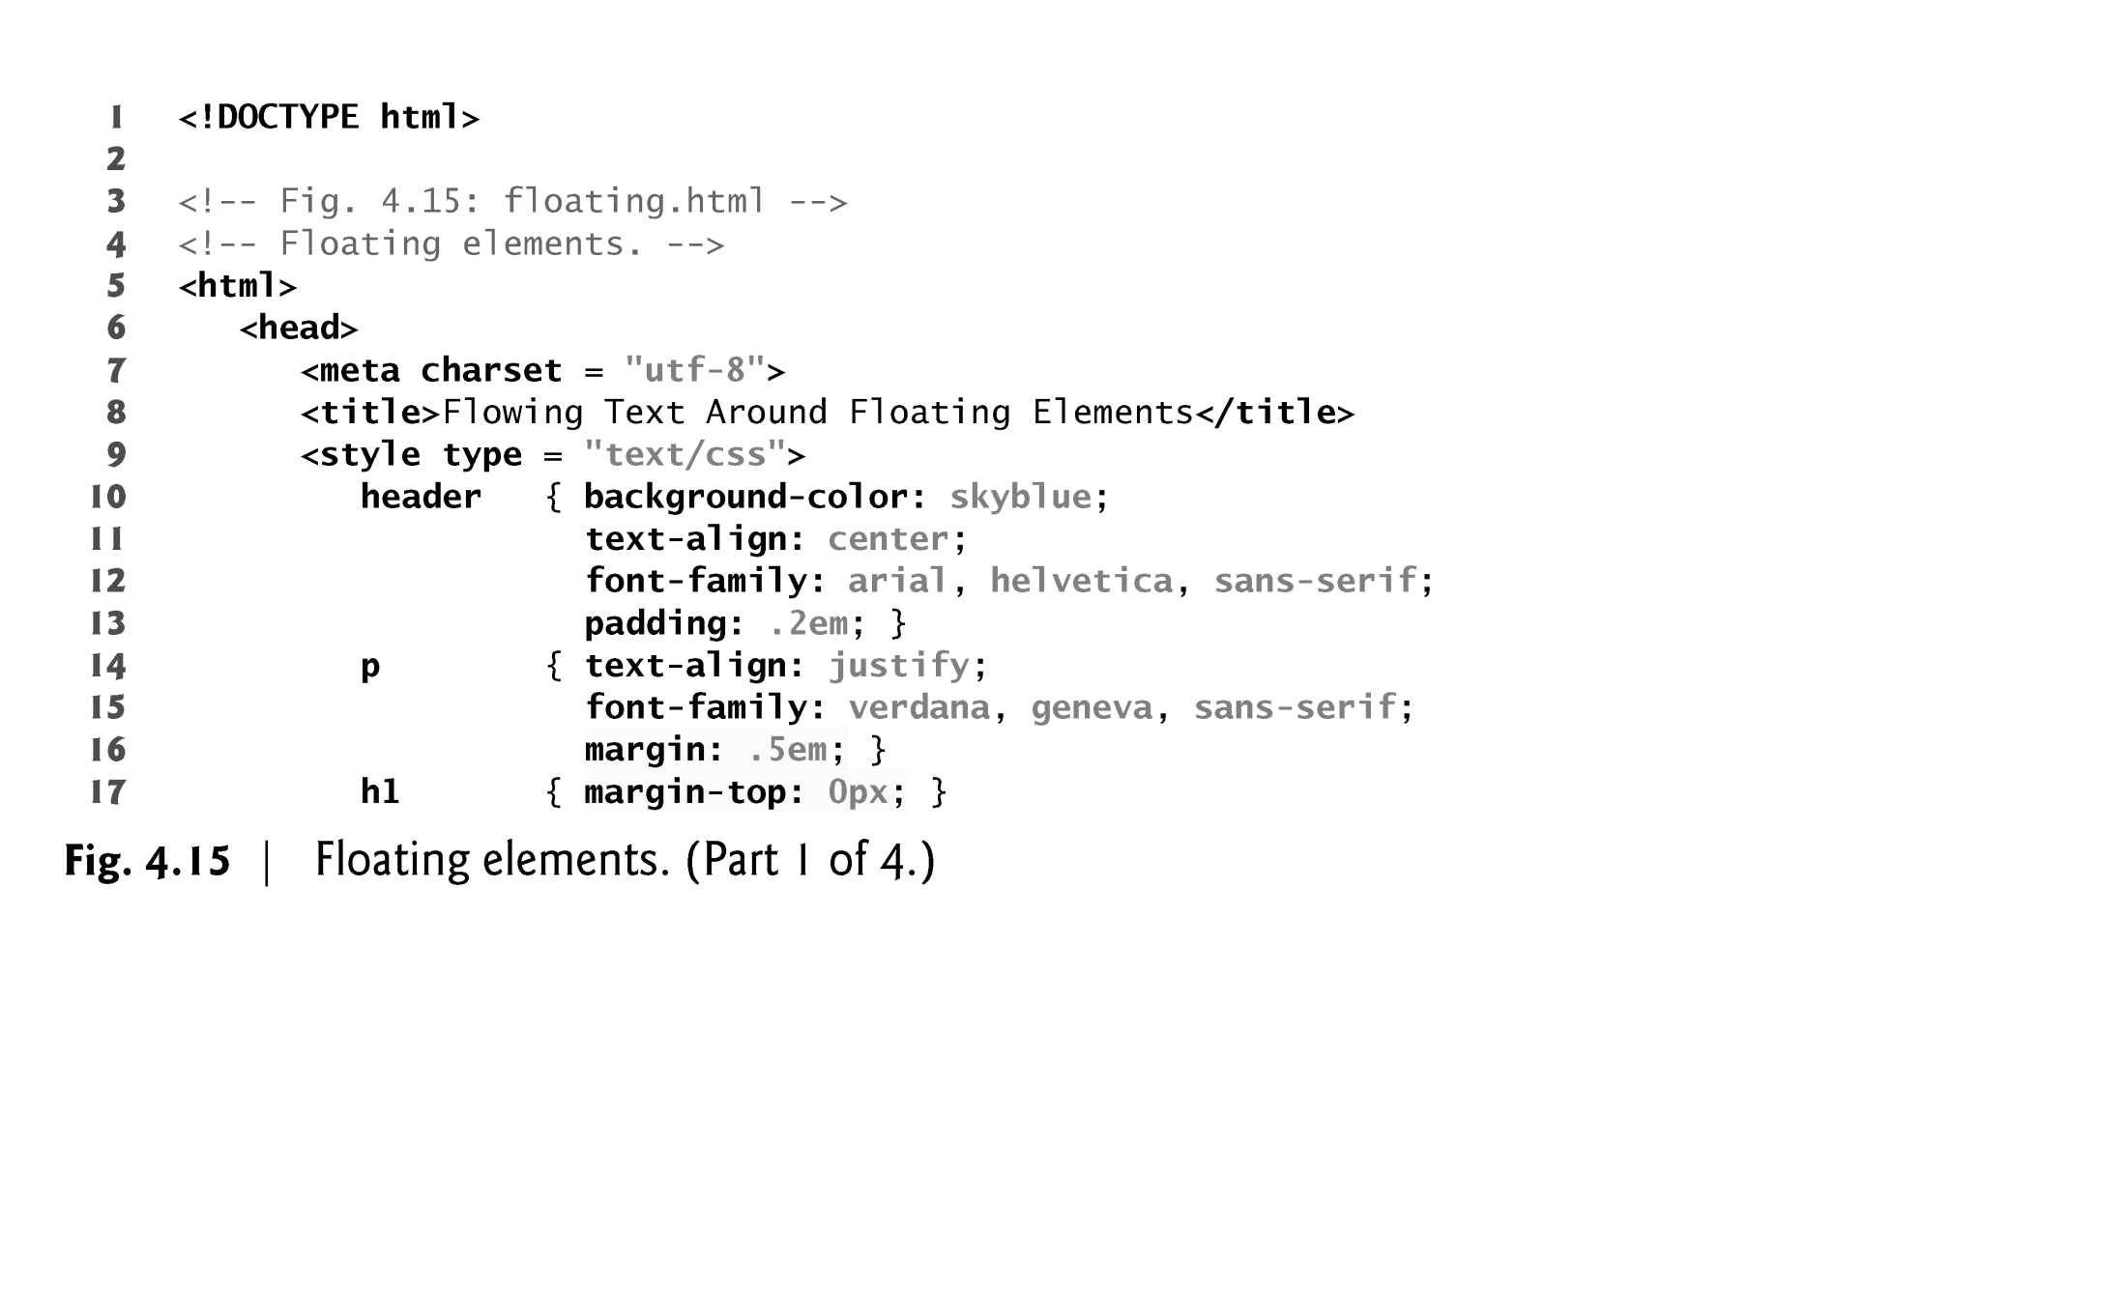

Slide 85
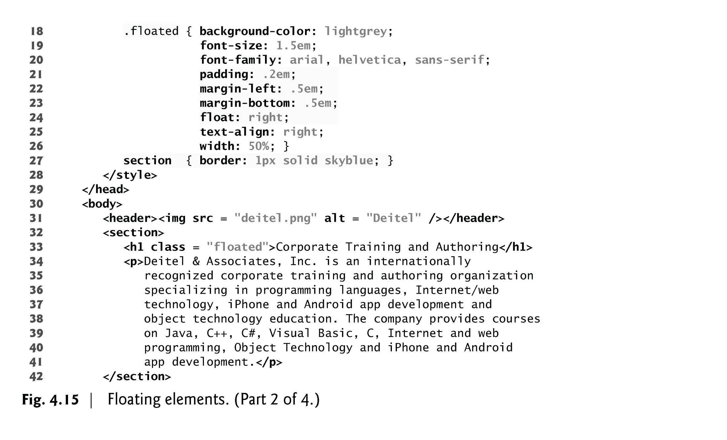

Slide 86
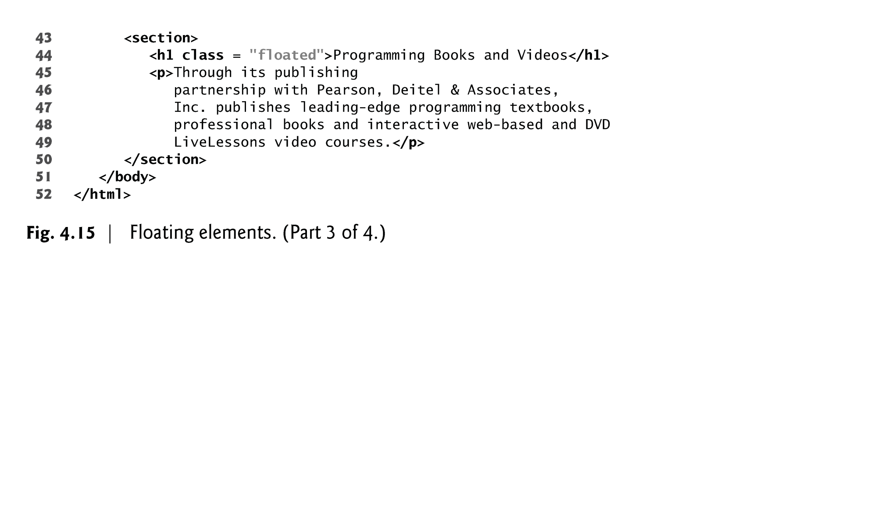

Slide 87
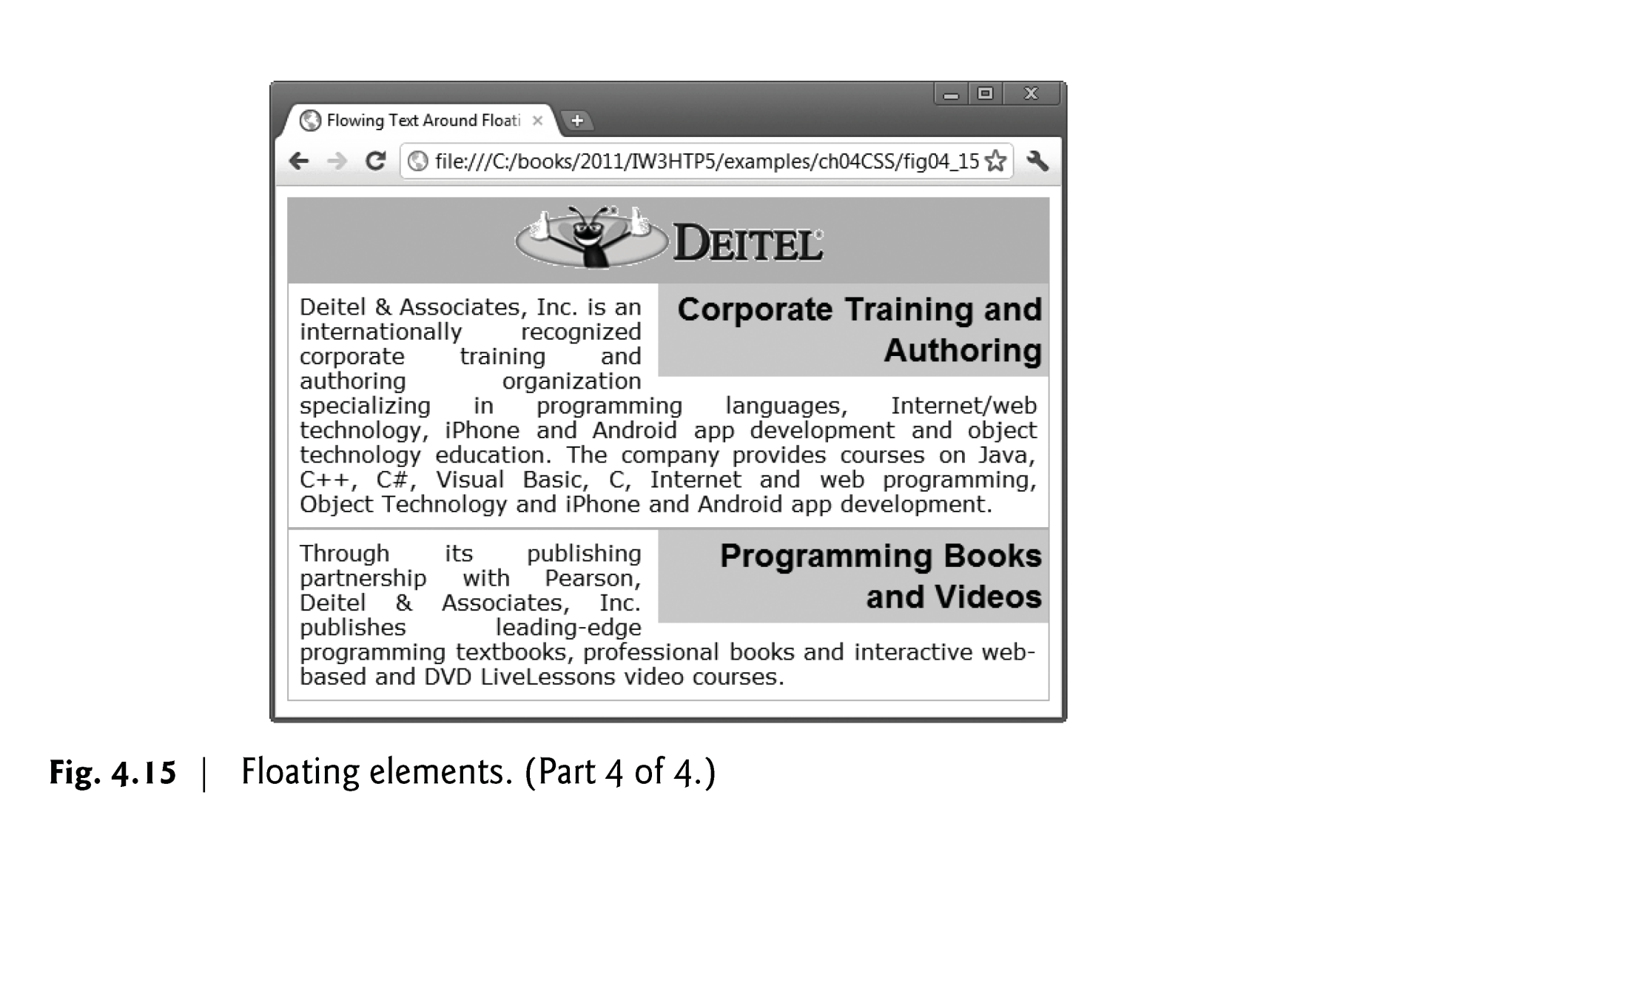

Slide 88
4.10 Box Model and Text Flow (Cont.)
margin and padding Properties
The margin property sets the space between the outside of an element’s border and all other content on the page.
The padding property determines the distance between the content inside an element and the inside of the element’s border.
Margins for individual sides of an element can be specified by using the properties margin-top, margin-right, margin-left and margin-bottom.
Padding can be specified in the same way, using padding-top, padding-right, padding-left and padding-bottom.

Slide 89
4.11 Media Types and Media Queries
CSS media types
allow you to decide what a page should look like depending on the kind of media being used to display the page
Most common media type for a web page is the screen media type, which is a standard computer screen

Slide 90
4.11 Media Types and Media Queries (Cont.)
A block of styles that applies to all media types is declared by @media all and enclosed in curly braces
To create a block of styles that apply to a single media type such as print, use @media print and enclose the style rules in curly braces

Slide 91
4.11 Media Types and Media Queries (Cont.)
Other media types in CSS include:
handheld
Designed for mobile Internet devices
braille
For machines that can read or print web pages in braille
speech
Allow the programmer to give a speech-synthesizing web browser more information about the content of the web page
print
Affects a web page’s appearance when it is printed

Slide 92
4.11 Media Types and Media Queries (Cont.)
Figure 4.16 gives a simple classic example that applies one set of styles when the document is viewed on all media (including screens) other than a printer, and another when the document is printed.
To see the difference, look at the screen captures below the paragraph or use the Print Preview feature in your browser if it has one.

Slide 93
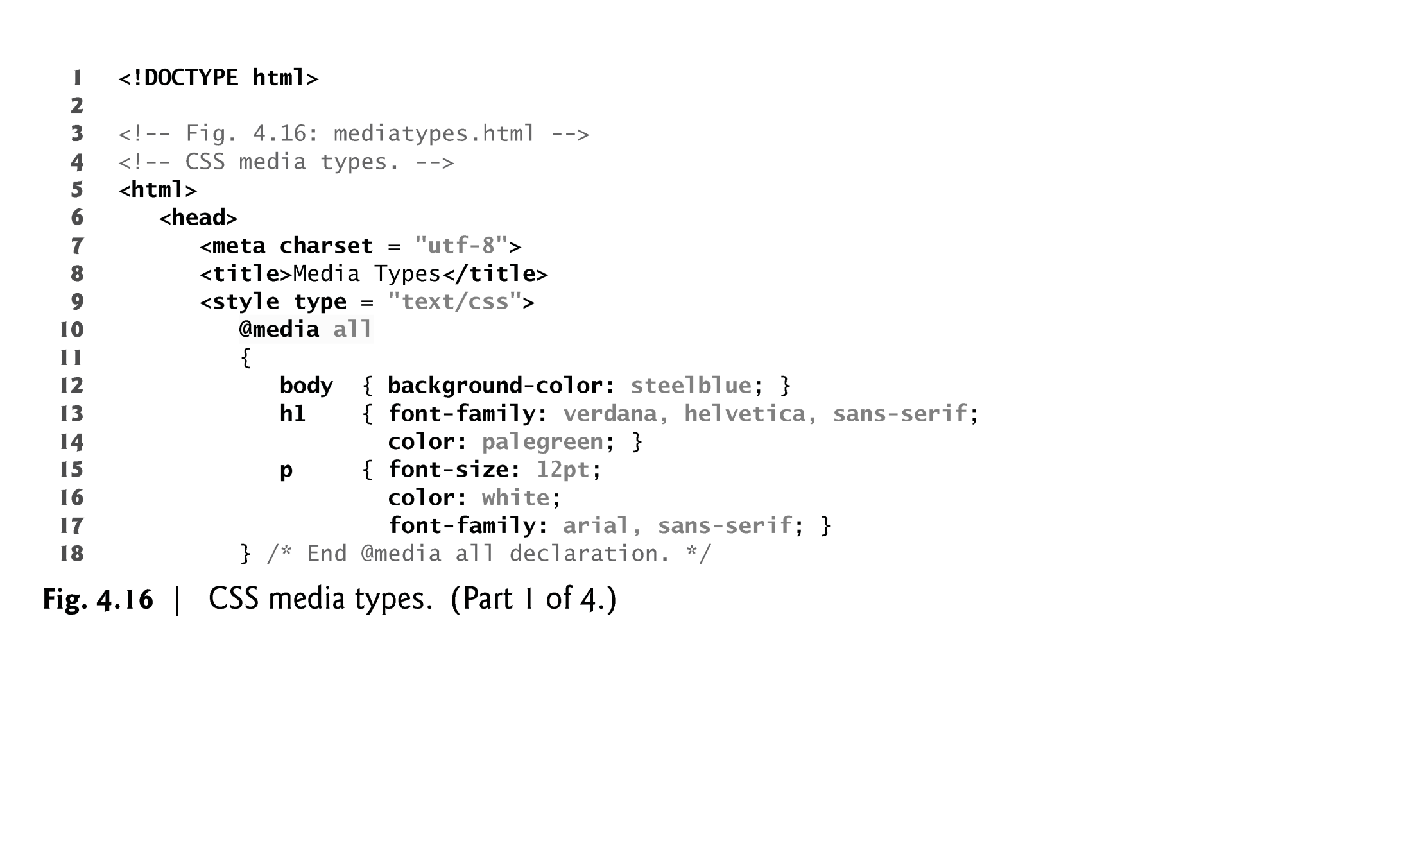

Slide 94
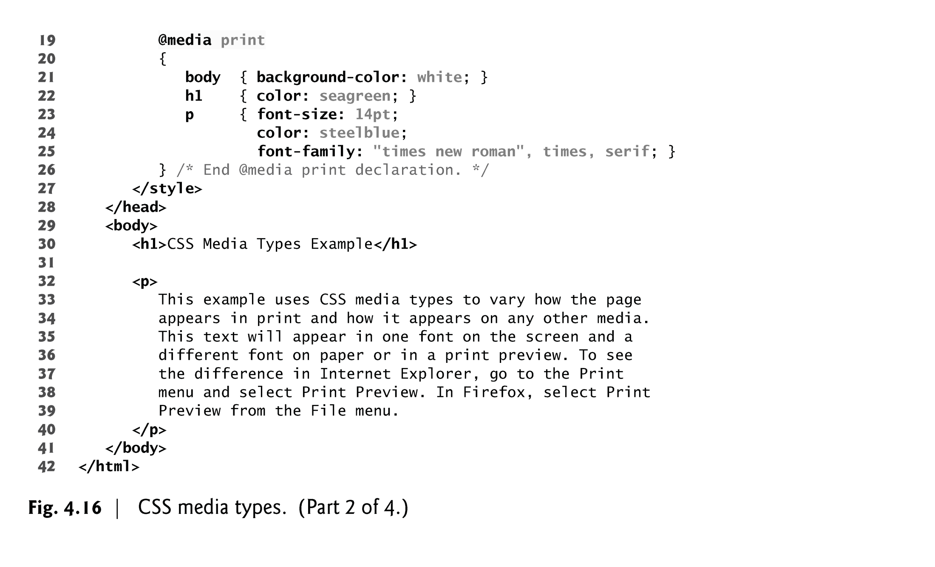

Slide 95
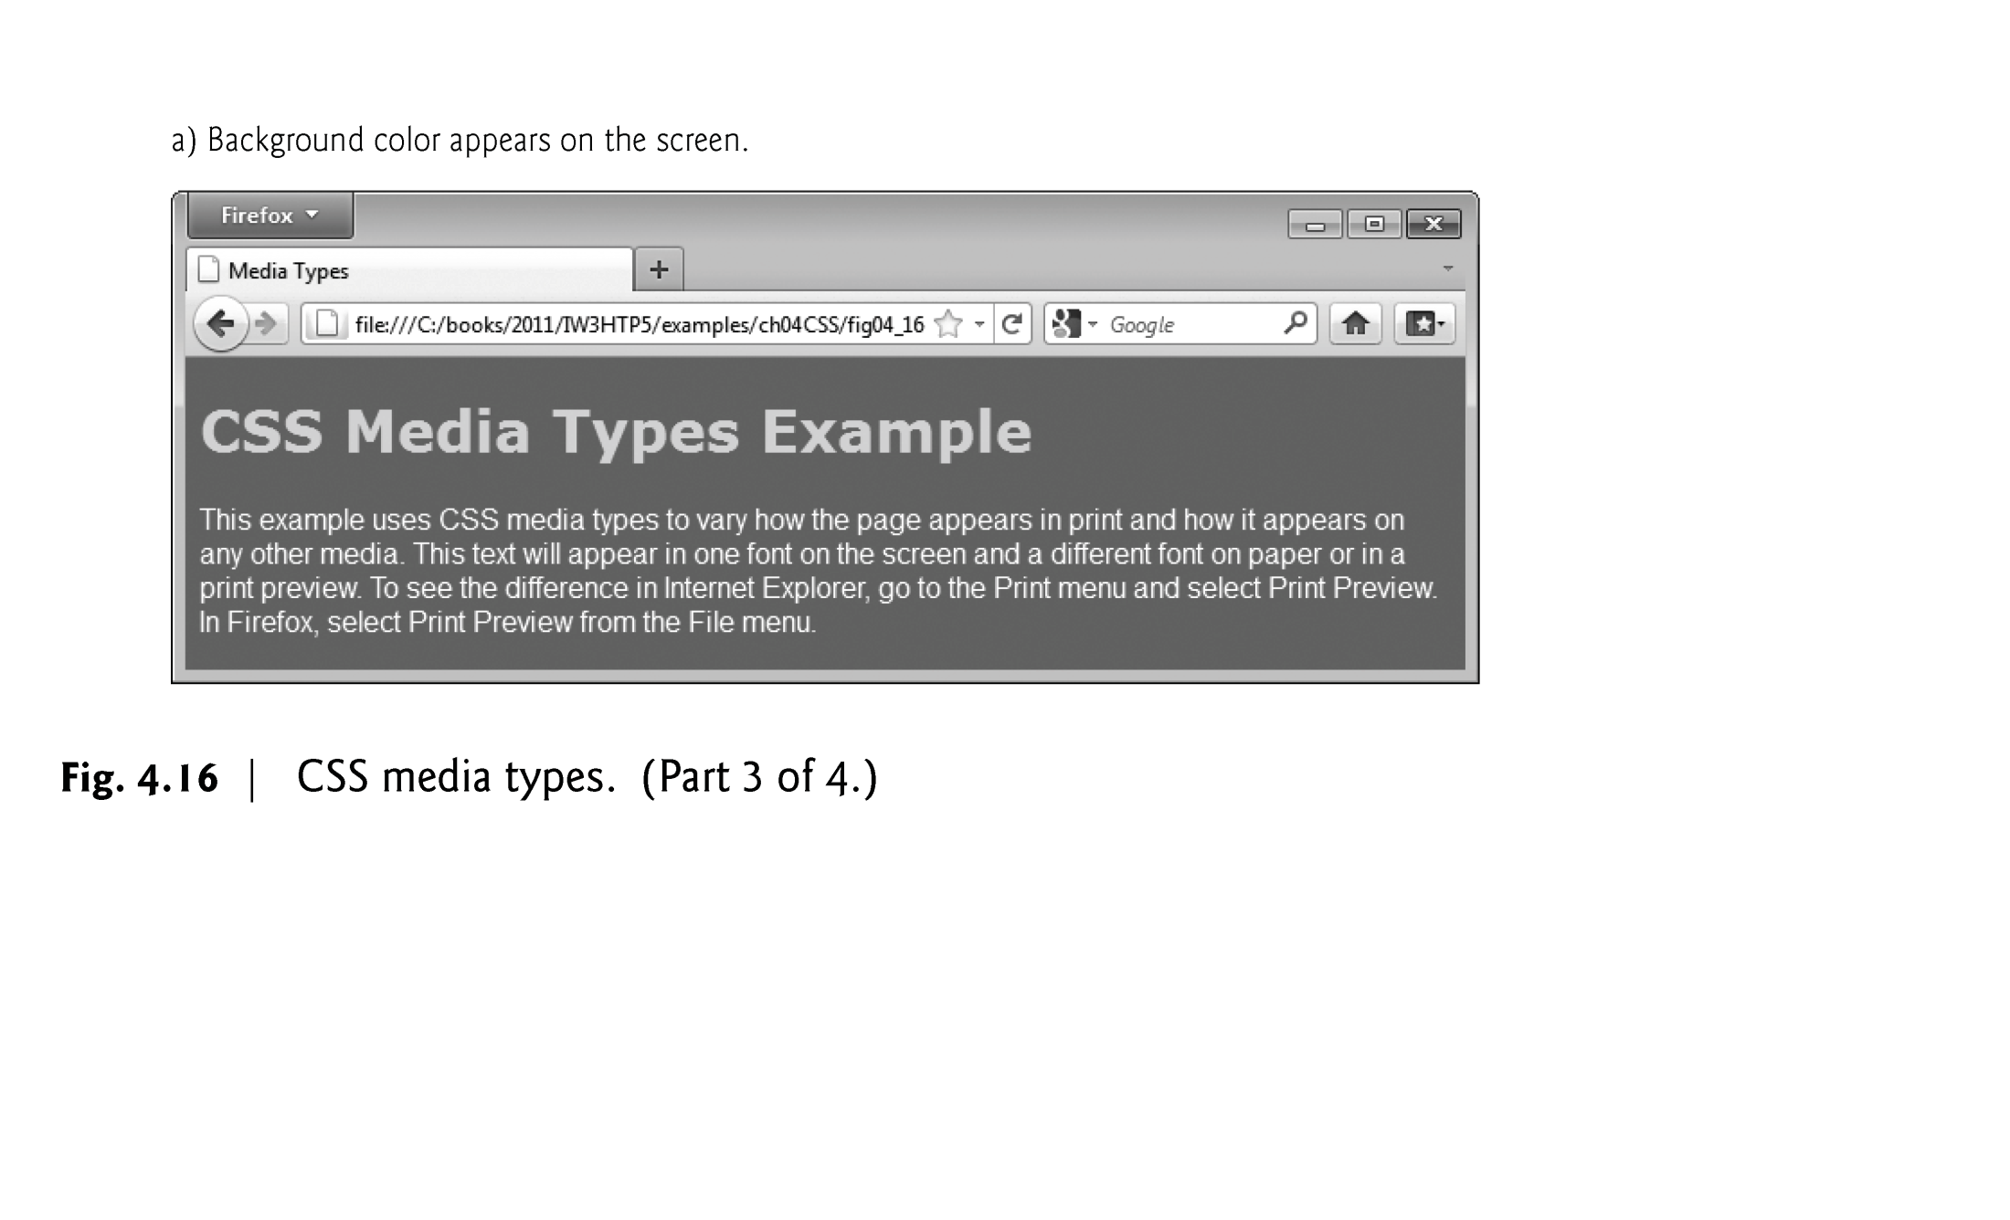

Slide 96
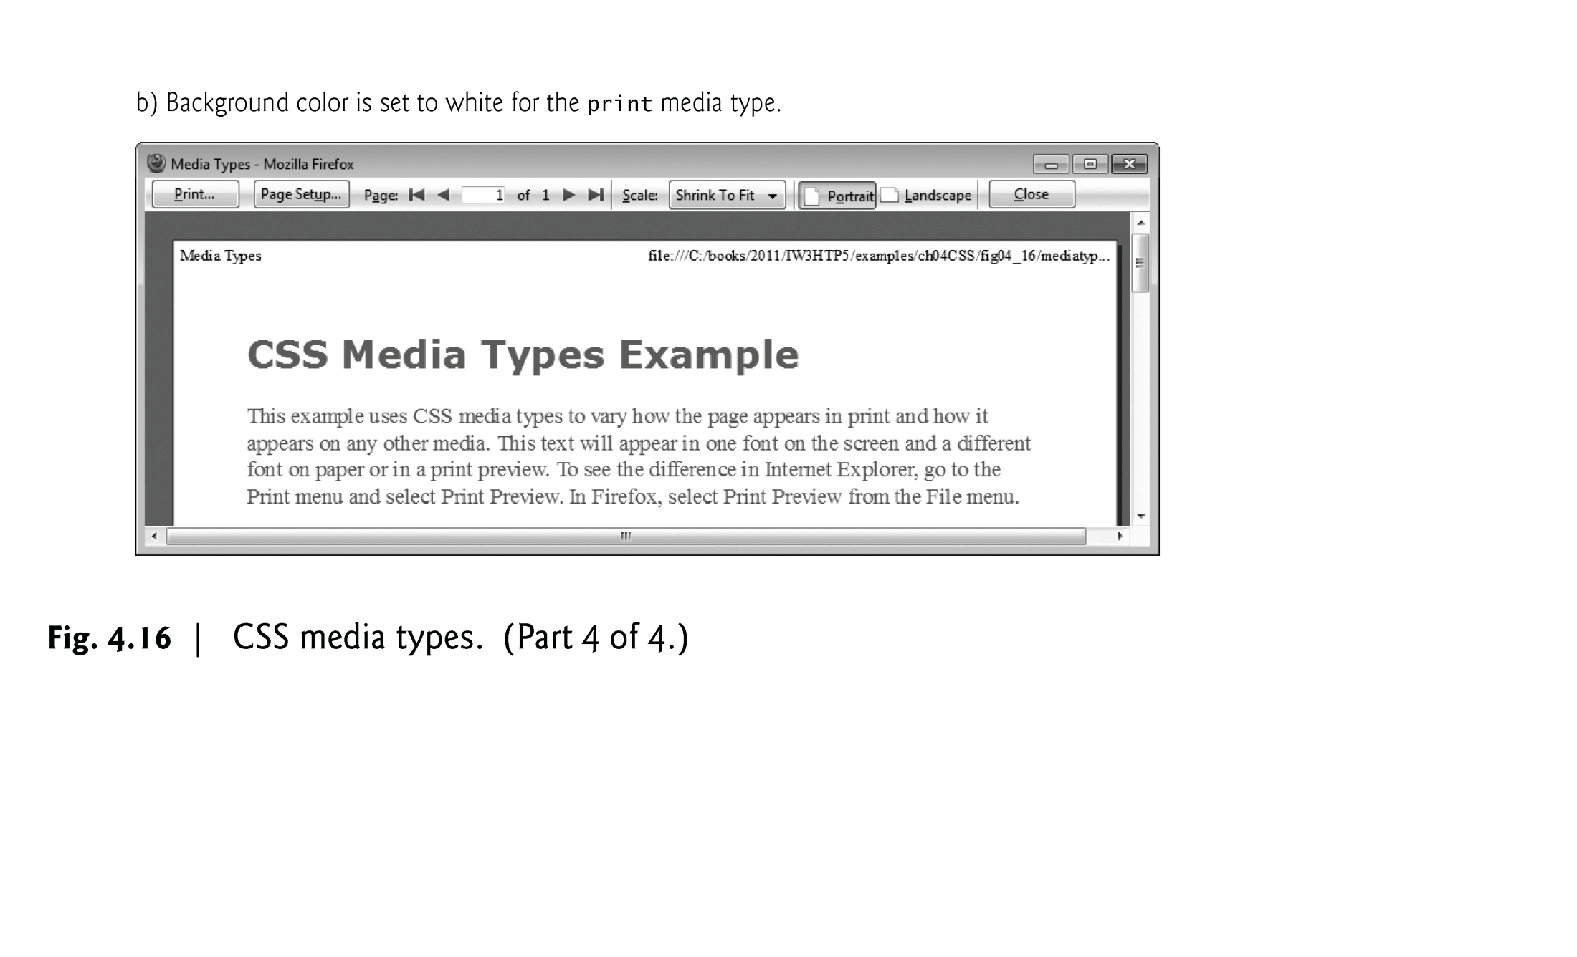

Slide 97
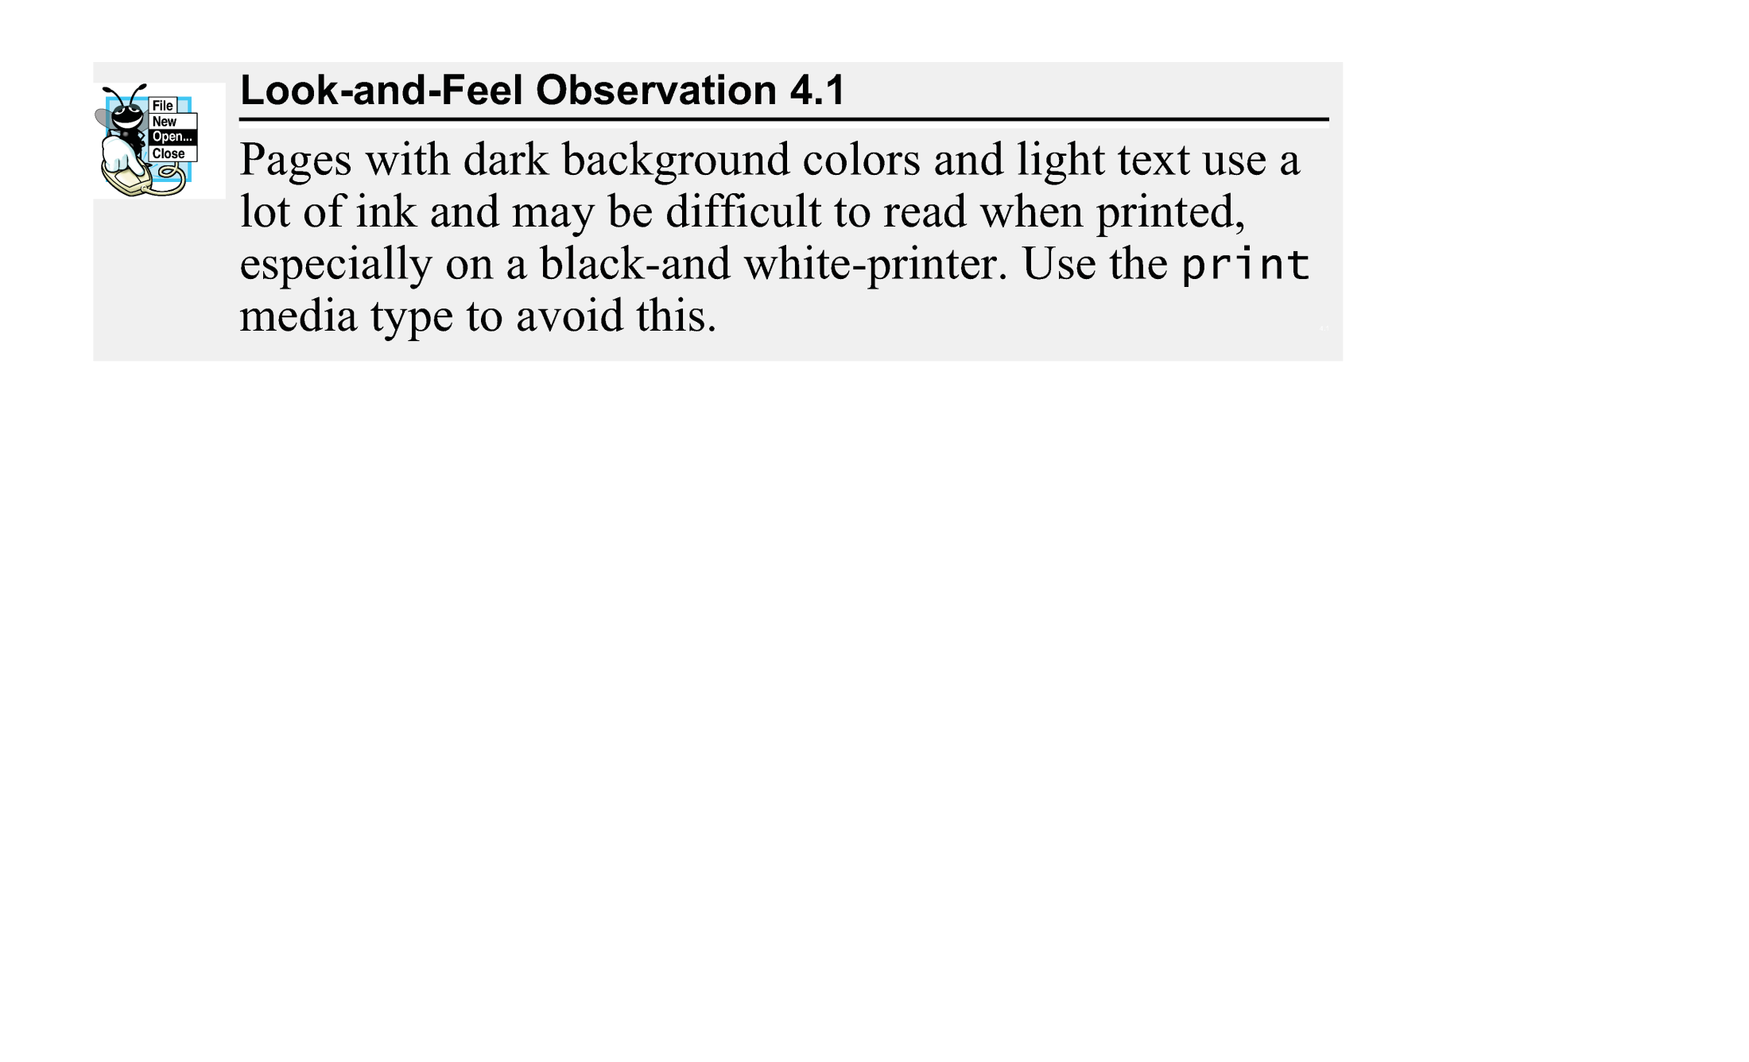

Slide 98


Slide 99
4.11 Media Types and Media Queries (Cont.)
Media Queries
Allow you to format your content to specific output devices.
Include a media type and expressions that check the media features of the output device.
Common media features include:
width—the width of the part of the screen on which the document is rendered, including any scrollbars
height—the height of the part of the screen on which the document is rendered, including any scrollbars
device-width—the width of the screen of the output device
device-height—the height of the screen of the output device
orientation—if the height is greater than the width, orientation is portrait, and if the width is greater than the height, orientation is landscape
aspect-ratio—the ratio of width to height
device-aspect-ratio—the ratio of device-width to device-height

Slide 100
4.12 Drop-Down Menus
:hover pseudoclass
used to apply styles to an element when the mouse cursor is over it
display property
allows a programmer to decide if an element is displayed as a block element, inline element, or is not rendered at all (none)

Slide 101


Slide 102


Slide 103


Slide 104


Slide 105


Slide 106
4.13 (Optional) User Style Sheets
Users can define their own user style sheets to format pages based on their preferences
Absolute font size measurements override user style sheets, while relative font sizes will yield to a user-defined style
User style sheets are not linked to a document; rather, they are set in the browser’s options

Slide 107
4.13 (Optional) User Style Sheets
Figure 4.18 contains an author style.
User style sheets are external style sheets. Figure 4.19 shows a user style sheet that sets the body’s font-size to 20pt, color to yellow and background-color to navy. The font-size value specified in the user style sheet conflicts with the one in line 10 of Fig. 4.18.

Slide 108


Slide 109


Slide 110


Slide 111
4.13 (Optional) User Style Sheets
Adding a User Style Sheet
User style sheets are not linked to a document; rather, they’re set in the browser’s options.
To add a user style sheet in IE9, select Internet Options..., located in the Tools menu. In the Internet Options dialog (Fig. 4.20) that appears, click Accessibility..., check the Format documents using my style sheet checkbox, and type the location of the user style sheet.
To add a user style sheet in Firefox, find your Firefox profile using the instructions at
www.mozilla.org/support/firefox/profile#locate
Place a style sheet called userContent.css in the chrome subdirectory.
For information on adding a user style sheet in Chrome, see
www.google.com/support/forum/p/Chrome/thread?tid=1fa0dd079dbdc2ff&hl=en.

Slide 112


Slide 113
4.13 (Optional) User Style Sheets
The web page from Fig. 4.18 is displayed in Fig. 4.21, with the user style sheet from Fig. 4.19 applied.

Slide 114


Slide 115
4.13 (Optional) User Style Sheets
Defining font-size in a User Style Sheet
Figure 4.22 changes the font-size property to use a relative measurement that does not override the user style set in Fig. 4.19.
Instead, the font size displayed is relative to the one specified in the user style sheet.

Slide 116


Slide 117


Slide 118
4.13 (Optional) User Style Sheets
Figure 4.23 displays the web page from Fig. 4.22 in Internet Explorer with the user style sheet from Fig. 4.19 applied.
Note that the second line of text displayed is larger than the same line of text in Fig. 4.21.

Slide 119


